Slide 1
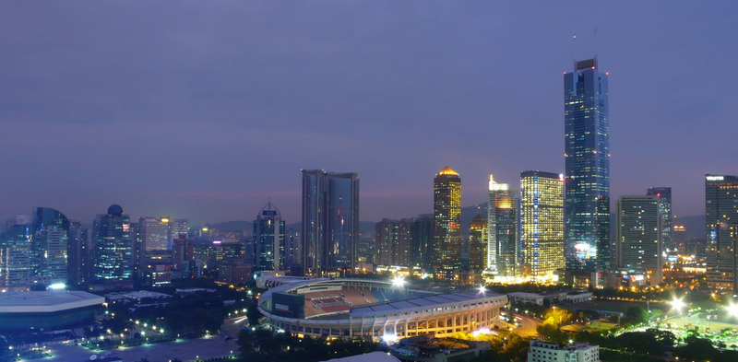
APHG Review
Part III

Slide 2
Industry

Slide 3
Economic Activities
Primary
Raw Materials: Agriculture, mining, fishing, and forestry
Secondary
Manufacturing: capital (for industry) and consumer goods
Tertiary
Consumer: retail and personal services; entertainment
Quaternary
Business/Producer services: trade, insurance, banking, advertising, transportation and information services
Quinary
Public (government) Services: health, education, research, transportation, tourism & recreation
These three levels are often subdivided within the economic activity group “tertiary” as services may be utilized by both consumers & producers.

Slide 4
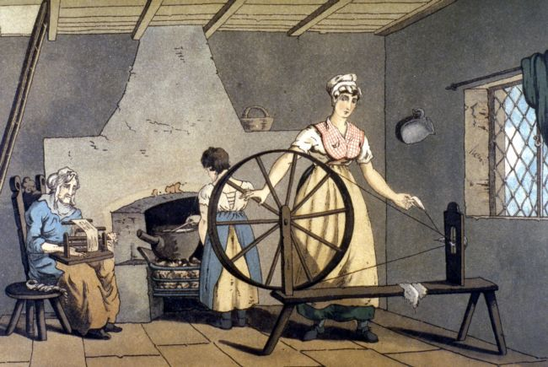
Cottage Industry
Home-based manufacturing found mainly before the IR.

Slide 5
Industrial Revolution 1760-1850
Series of improvements in industrial technology that transformed the process of manufacturing goods.
Started in England, diffused to Western Europe and then to the United States by 1825.
Large Coal deposits were an integral part of the start and diffusion of the IR.

Slide 6
Diffusion of the Industrial Revolution to Mainland Europe
Early 1800 innovations diffused to mainland Europe, Germany and the low countries.
Proximity to coal fields
Proximity to water
Later 1800 innovations
Location criteria included proximity to railroads. London and Paris became big centers of Industry

Slide 7
Industrial Revolution Hearths
Fig. 11-1: The Industrial Revolution originated in areas of northern England. Factories often clustered near coalfields

Slide 8
Manufacturing Regions
Fig. 11-3: The world’s major manufacturing regions are found in North America, Europe, and East Asia. Other manufacturing centers are also found elsewhere.

Slide 9
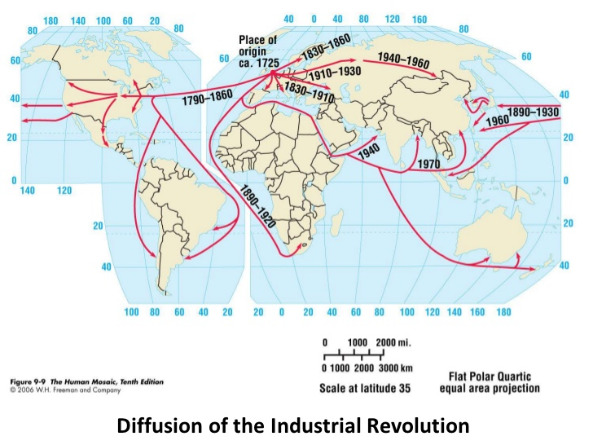

Slide 10
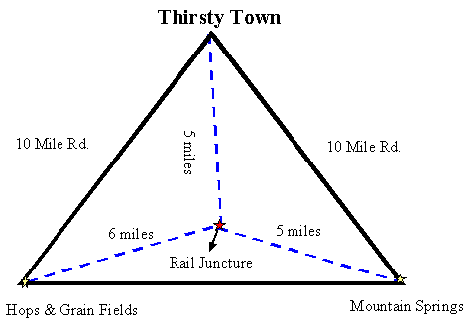
Weber’s Least Cost Theory
Where should an industry be located?

Slide 11
3 major factors that determine location of manufacturing
1. Transportation (most important)
Raw materials (inputs) to factory
Finished goods (outputs) to market
Distance and weight most important factors.
2. Labor
High labor costs reduce profit
May locate farther from inputs/ market if cheap labor can make up for added transport costs.
3. Agglomeration
Similar businesses cluster in the same area.
Businesses support each other, reduce costs

Slide 12
Bulk Reducing
Heavier input, shorter distance to plant
Input Factory Market
Input Factory Market
Lighter output, longer distance to market, lo
Lighter input, longer distance to plant.
Bulk Gaining
Heavier output,
shorter distance to market

Slide 13
Agglomeration
The concept industries clump together for mutual advantages .
Grouping together of many firms from the same industry in a single area for collective or cooperative use of infrastructure and sharing of labor resources
Example: Silicon Valley (also called in APHG a technopole)

Slide 14
Silicon Valley

Slide 15
URBAN Patterns

Slide 16
Burgess’ Land Use Model Developed in the 1920s
As used in urban areas: society within an urban area is often arranged in a series of concentric rings in positions defined by social factors.
The most expensive land is often in the center the city and the land on the edge of the city is cheaper.
Cities grew outwards from the original site so the oldest buildings would be in the middle of the city and the youngest would be on the edge.

Slide 17
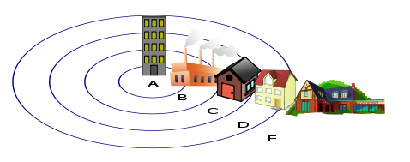
Burgess Model
Central Business District (CBR)
Zone in transition
Zone of independent workers' homes
Zone of better residences
Commuter's Zone

Slide 18
Bid Rent Curve
Space for downtown commercial real estate is sold or leased by the square foot. By comparison, land in the suburbs is sold by the acre. Along the curve you could plot different land uses.
Land for a suburban home or space for a suburban apartment building are not that much different in price. However, land for that apartment building and land for building downtown is vastly different in price.
The bid-rent curve represents the cost-to-distance relationship of real estate prices in the urban landscape.
The closer one moves toward the peak land or CBD, the more expensive the price for CBD land.

Slide 19
Rank-Size Distribution of Settlements
Geographers observe that ranking cities/towns from largest to smaller population produces a regular pattern of hierarchy.
This is the Rank-Size Rule. The country’s nth-largest settlement is 1/n the population of the largest settlement.
In other words, the second-largest city is one-half the size of the largest, the fourth-largest city is one-fourth the size of the largest, and so on.
The United States’ cities follow Rank-Size Rule. New York is largest, ½ of New York is Los Angeles, a 1/3 of New York is Chicago, a ¼ of New York is Philadelphia, etc.

Slide 20
Rank-size Distribution

Slide 21
Primate City Distribution of Settlements
If the settlement hierarchy does not graph as a straight line, then the country does not have a rank-size distribution of settlements.
Instead, it may follow the primate city rule. This is where the largest settlement has more than twice as many people as the second-ranking settlement. In this distribution, the country’s largest city is called the primate city.
Denmark: Copenhagen is the primate city with 1 million inhabitants. The second largest is Arhus with only 200,000.
United Kingdom/England: London has 8 million, whereas as Birmingham, the second-largest – has only 2 million.

Slide 22
The three Urban Land Use Models

Slide 23
Central Place Theory Walter Christaller
Theory explains how the most profitable location can be identified.
A central place is a market center for the exchange of goods and services by people attracted from the surrounding area.
Businesses in central places compete against each other to serve as markets for goods and services for the surrounding region.
Market area or Hinterland The area surrounding a service from which customers are attracted
To establish a market area, a circle is drawn around the node of a service on a map. The territory around the circle is its market area.

Slide 24
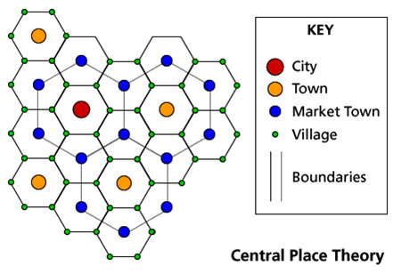

Slide 25
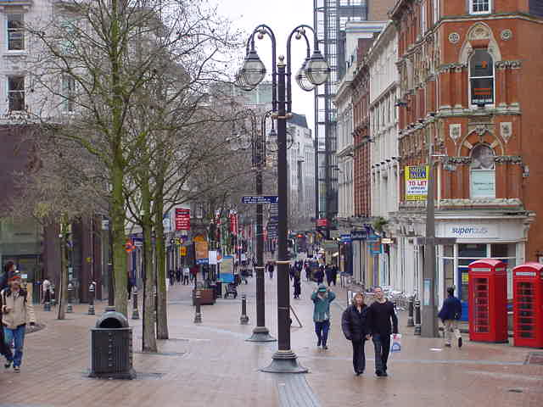
Services Tertiary Sector of Economic Activities

Slide 26
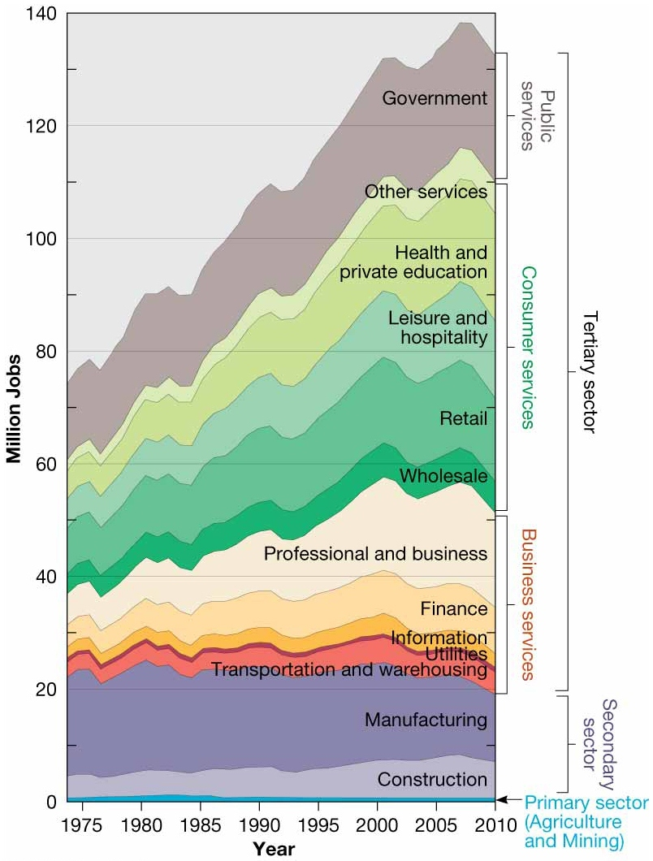
TYPES of SERVICES
-Public
-Consumer Services
-Business

Slide 27
Types of Services

Slide 28
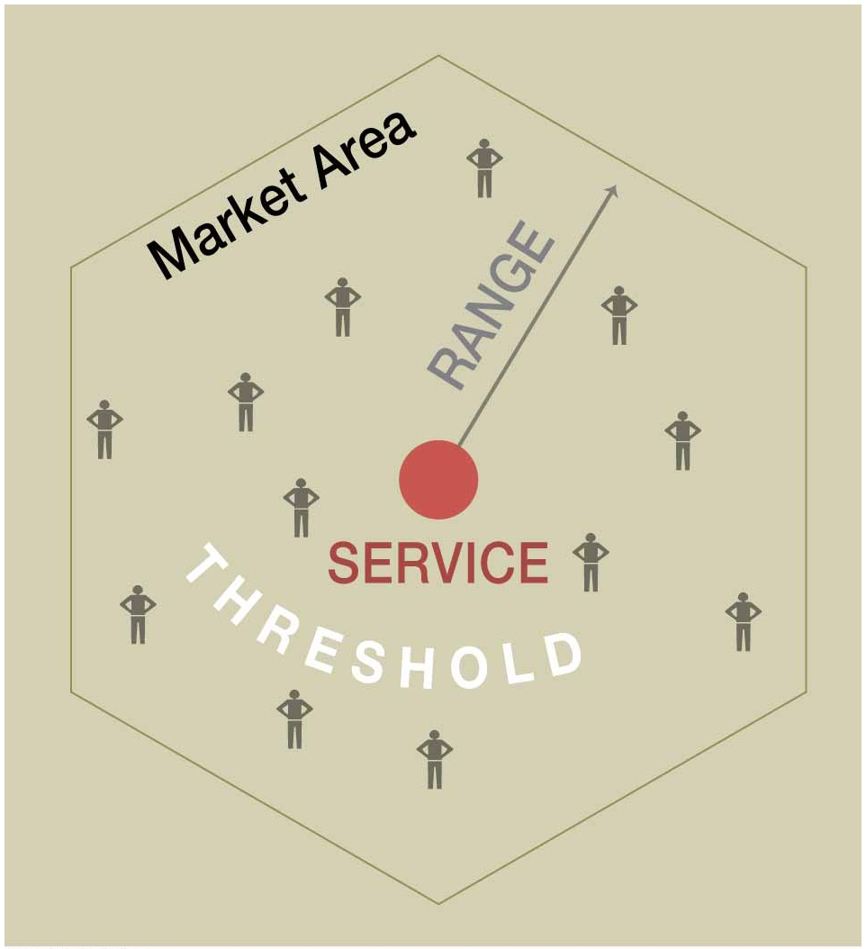

Slide 29
RANGE of Service
Maximum distance people are willing to travel to use a service.
People are willing to go only a short distance for everyday consumer services, such as groceries and pharmacies.
But they will travel longer distances for other services such as a concert or professional ball game.
Therefore, the range of a service must be determined from the radius of a circle that is irregularly shaped rather than perfectly round. The irregularly shaped circle takes in the territory for which the proposed site is closer than competitors’ sites.

Slide 30
THRESHOLD of a Service
The minimum number of people/customers needed to support the service in order to make a profit.
Once the range has been determined, a service provider must determine whether a location is suitable by counting the potential customers inside the irregularly shaped circle.
How expected consumers inside the range are counted depends on the product.
Convenience stores and fast-food restaurants appeal to nearly everyone, whereas other goods and services appeal primarily to certain consumer groups.

Slide 31
Services in CBDs
Public Services
City hall, state agencies and libraries
Sports facilities (stadiums)
Business Services
Banking, finance, journalism, law firms
Consumer Services
Retail stores with HIGH TRESHOLD and HIGH RANGE
Retail services for downtown workers.

