Slide 1
Catal Huyuk Artifacts Investigation
Catal Huyuk is the Turkish name for a Neolithic archaeological site in Turkey. Several significant artifacts from this site are displayed in the Museum of Anatolian Civilizations in Ankara, Turkey. These are artifacts from the research conducted by Professor James Mellaart between 1961 and 1965. The figurines and wall paintings are extremely significant in the history of religion and art.

Slide 2
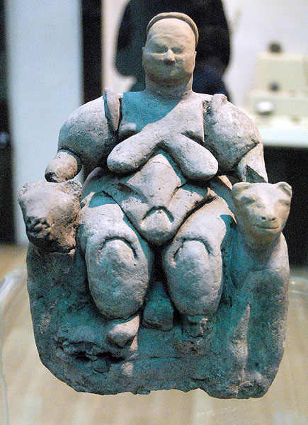
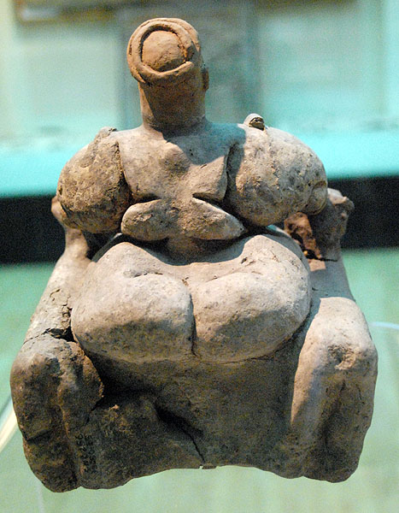
Artifact #1
Seated mother goddess figurine from Catal Huyuk, circa 5800 BC. Made out of clay - height 16.5 cm (without head). Found in a grain bin in Shrine A II; the head has been restored.

Slide 3
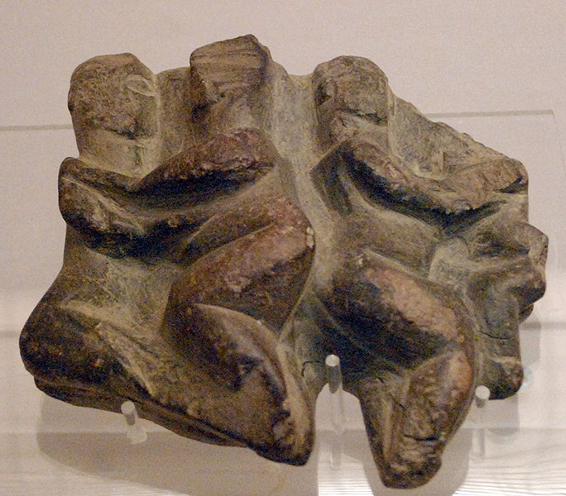
Artifact #2
Relief out of greenish-grey. Dated from 6000 to 5500 BC. Discovered in shrine VI.A.30 and measures 11.5 cm in height.

Slide 4
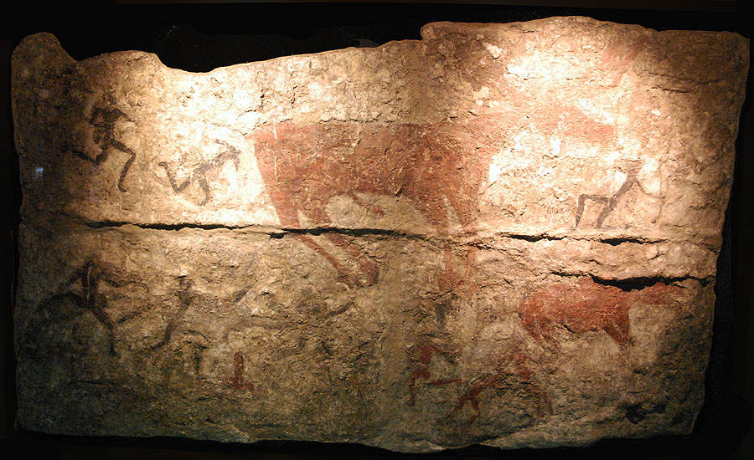
Artifact #3
Wall painting.

Slide 5
Artifact #4
Flint dagger with a handle in shape of snake; Shrine VI.B.29. Length 10.3 cm.

Slide 6
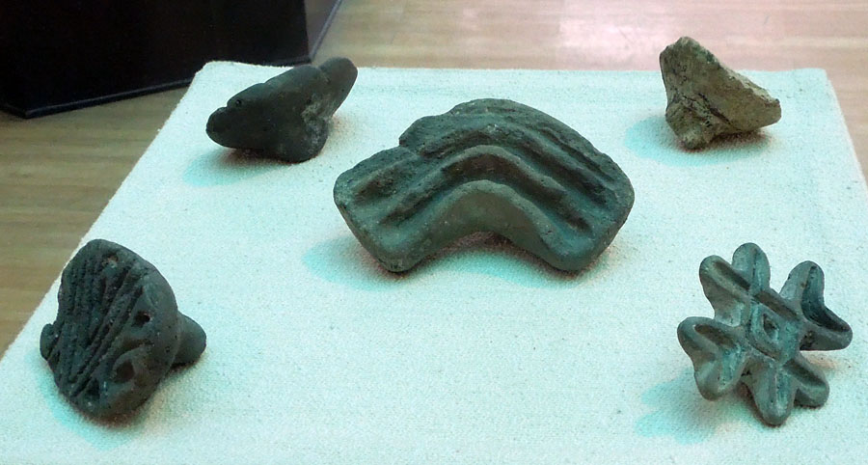
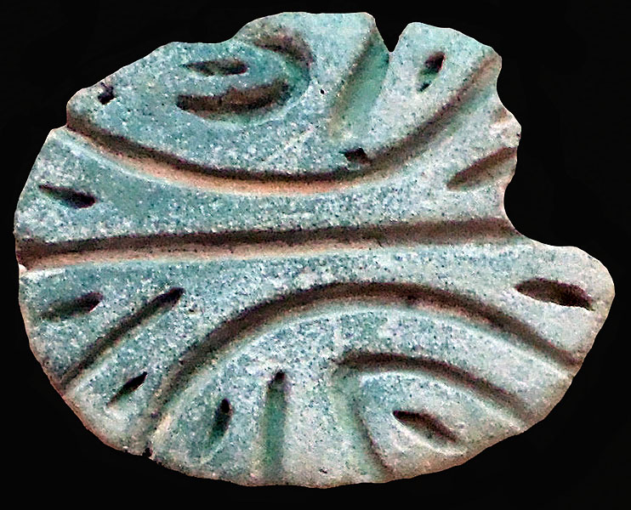
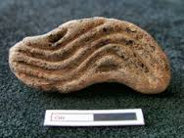
Artifact #5
Clay stamps. 3-6 cm.

Slide 7
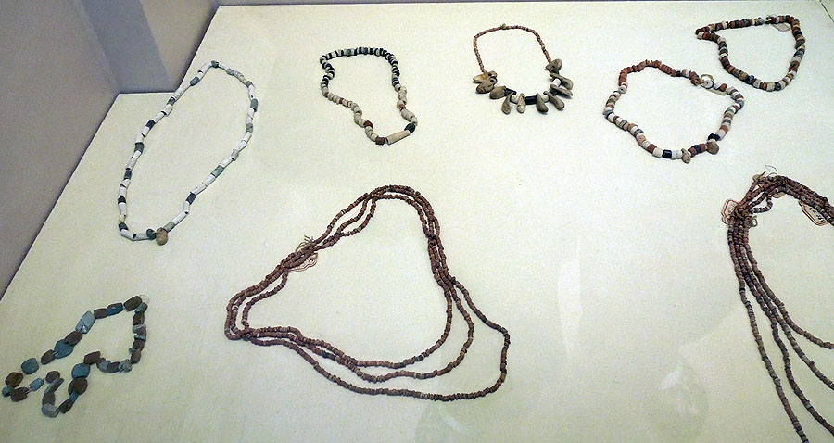
Artifact #6
Strings of necklaces made from stone, deer teeth, and bone.

Slide 8
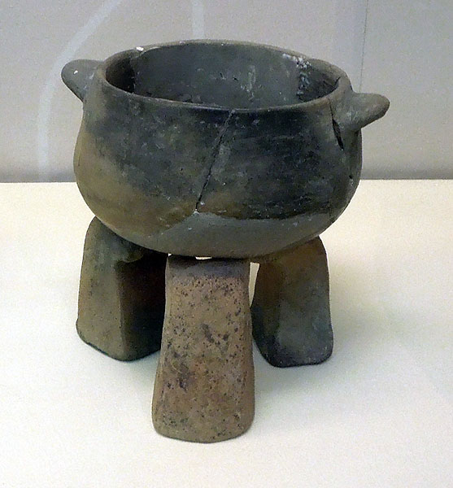
Artifact #7
Small pot and three pot supports. Height of the pot is 8.5 cm and the pot stands range from 7.9 to 8.6 cm.

Slide 9
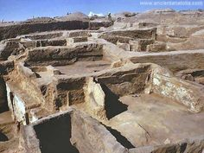
Artifact #8
Overhead view of dig site.

