Slide 1
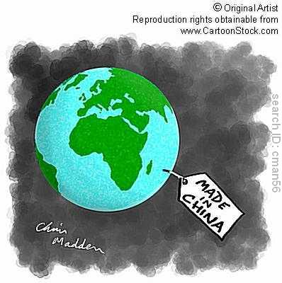
Globalized Economy
Development in the LDCs

Slide 2
Models of Development
Development through self-sufficiency refers to the state of not requiring any outside aid, support, or interaction, for survival. States that use the self-sufficiency model implement trade barriers such as tariffs and trade quotas on other countries to protect their own industries and businesses.
Development through international trade involves a country finding their unique economic assets that other countries are willing to buy. What product can the country manufacture and distribute at higher quality at a lower cost than other countries? The international trade model will encourage less barriers to trade.

Slide 3
Self-Sufficiency
Pros:
Helps a fragile business by protecting them from large international corporations.
Cons:
Protectionist measures like tariffs, quotas and licenses tend to bring down the quality and speed of production/
A country with a lot of protectionist measures also has a large complex administrative job.

Slide 4
Globalization
Process of interaction and integration among people, companies and governments of different nations, a process driven by international trade and investment and aided by information technology.

Slide 5
International Trade model
Pros
Comparative advantage should improve the economy.
Protectionism is expensive (tariffs are passed onto consumers)
Economic interdependence undercuts the likelihood of war.
Introduction of capital and technology
Democratization
Cons
Threat to domestic jobs and industries.
Too much dependency on a few products
Security is endangered
Cultural Imperialism
Could negatively impact environmental and working standards in developing countries

Slide 6
World Systems Theory
The economic world is explained through the emergence of a core, periphery and semi-periphery system. The system was established in the 15th Century with the age of exploration when countries began to connect political and economically with each other. Immanuel Wallerstein clarified this system in the 1970s.

Slide 7
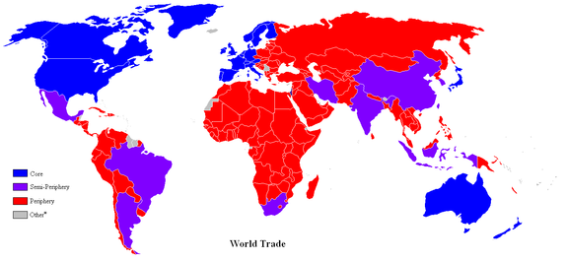
Core-periphery model
describes the pattern of distribution of the MDCs and LDCs. When the earth is viewed from the North Pole the MDCs are clustered near the center of the map (core) while the LDCs are near the edges (periphery).

Slide 8
The world is a capitalist system of interlocking states.
Global Economic Core: industrialized, developed countries that drive global economy. (Services)
Periphery: countries that are underdeveloped and were, usually, once colonies. (Natural Resources)
Semi periphery: countries that are between core and periphery. (Manufacturing)

Slide 9
World Trade Organization (WTO) and the promotion of free trade.
GOALS:
Reduction in trade restrictions (tariffs, quotas and licenses)
Reduction of restrictions on the international movement of money by banks, corporation's and wealthy people.
Settles disputes over International Trade.

Slide 10
Opposition to free trade and the WTO

Slide 11
Transnational Corporations (a.k.a.-Multi-Nationals)

Slide 12
Maquiladoras
U.S firms that have factories just outside the U.S/Mexican border in areas that have been specially designated by the Mexican government. In such areas, factories cheaply assemble goods for export back into the U.S.

Slide 13
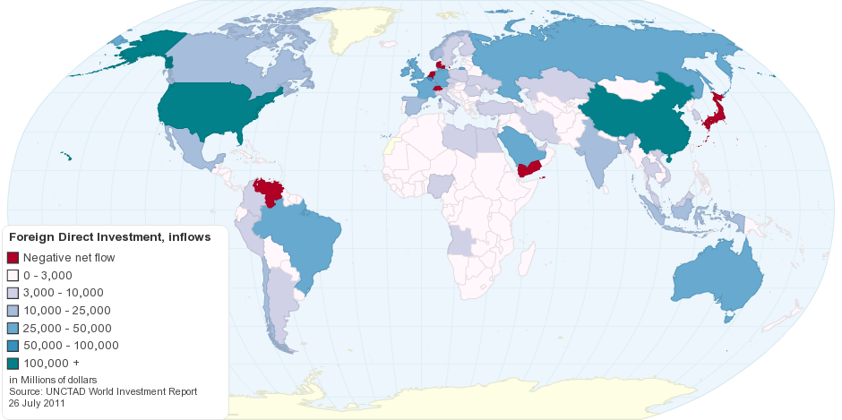
Foreign Direct Investment

Slide 14
How do LDCs get the money to develop?
The World Bank (supranational organization)
Economic Development
Bretton Woods Conference -1944
International Monetary Fund (IMF) (supranationalism)
Currency Exchange

Slide 15
Rostow’s Development Model
Development goes in stages
Each stage is a function of productivity, economic exchange, technological improvements, and income. Economic growth occurs when advancing from one stage to another.

Slide 16
Stages
1. Traditional Society 2. Transitional Society 3. Take-off 4. The Drive to maturity 5. High Mass Consumption

Slide 17
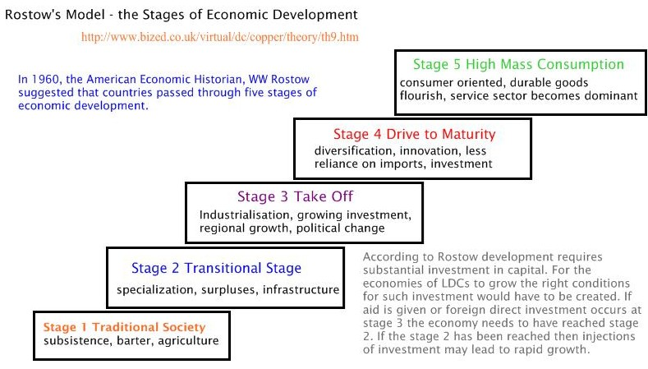

Slide 18
Fair Trade

Slide 19
