Slide 1
Industry
Origins, Distribution, Characteristics

Slide 2
Economic Activities
Primary
Raw Materials: Agriculture, mining, fishing, and forestry
Secondary
Manufacturing: capital (for industry) and consumer goods
Tertiary
Consumer: retail and personal services; entertainment
Quaternary
Business/Producer services: trade, insurance, banking, advertising, transportation and information services
Quinary
Public (government) Services: health, education, research, transportation, tourism & recreation
These three levels are often subdivided within the economic activity group “tertiary” as services may be utilized by both consumers & producers.

Slide 3
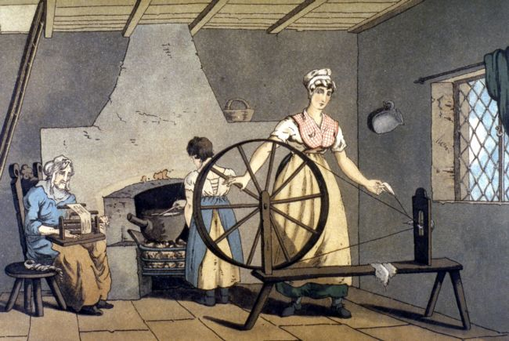
Cottage Industry
Home-based manufacturing found mainly before the IR.

Slide 4
James Watt and the Steam Engine 1769

Slide 5
Diffusion of the Industrial Revolution to Mainland Europe from England
Early 1800 innovations diffused to mainland Europe, Germany and the low countries.
Proximity to coal fields
Proximity to water
Later 1800 innovations
Location criteria included proximity to railroads. London and Paris became big centers of Industry

Slide 6
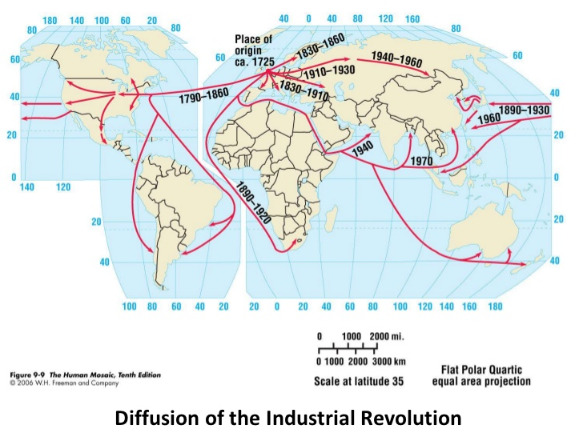

Slide 7
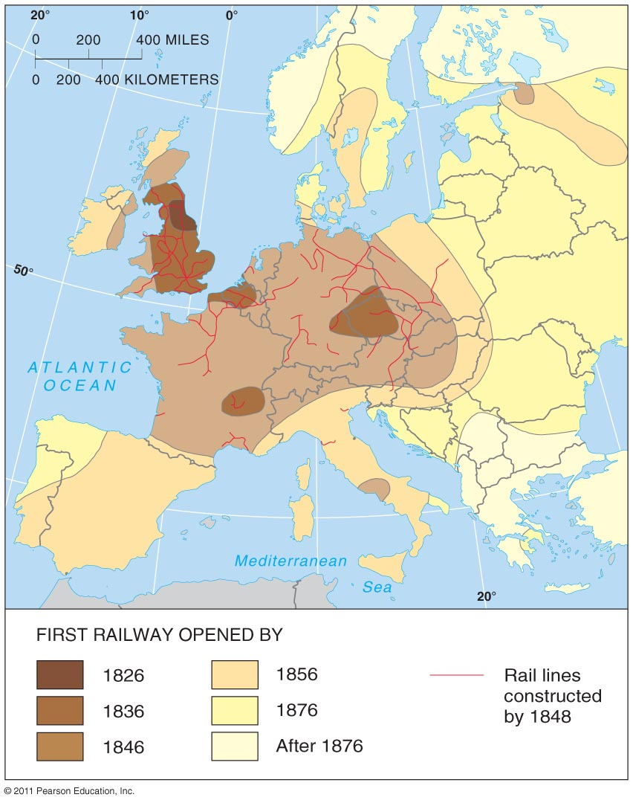

Slide 8
Industrial Revolution Hearths
Fig. 11-1: The Industrial Revolution originated in areas of northern England. Factories often clustered near coalfields

Slide 9
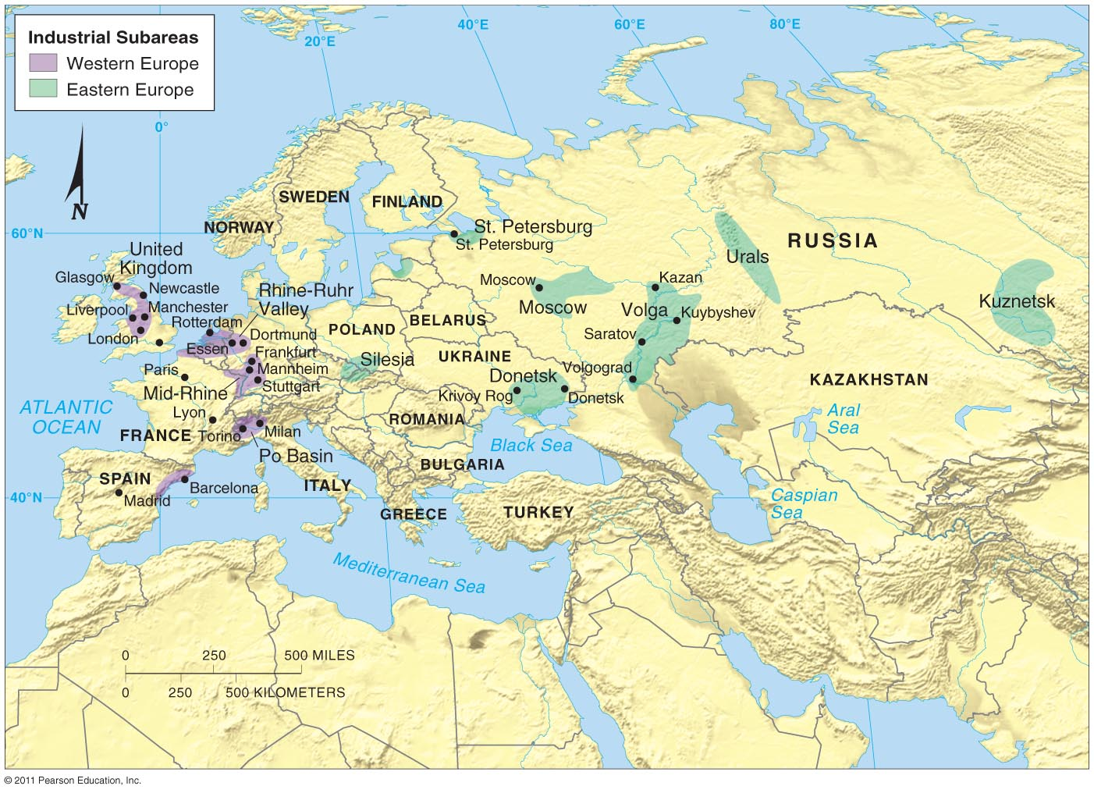

Slide 10
Manufacturing Regions know this kiddos!
Fig. 11-3: The world’s major manufacturing regions are found in North America, Europe, and East Asia. Other manufacturing centers are also found elsewhere.

Slide 11
Site and Situation Factors -WHY locate a factory “there”?
Situation -Location factors related to the transportation of materials to and from a factory and market proximity (Ports, Railroad).
Site -Location factors related to the costs of factors of production inside the plant, such as land, labor, and capital

Slide 12
Who?
Alfred Weber (1868-1958)
German Economic Geographer
Published Theory of Location of Industries in 1909.
“What is the best (most profitable) location for manufacturing plants?”

Slide 13
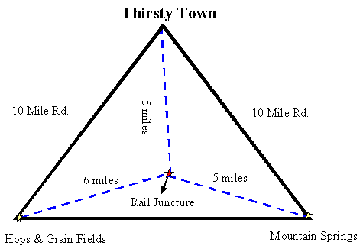
Weber’s Least Cost Theory
Where should an industry be located?
Model developed by Alfred Weber according to which the location of manufacturing
establishments is determined by the minimization of three critical expenses:
labor, transportation, and agglomeration

Slide 14
Bulk Reducing
Heavier input, shorter distance to plant
Input Factory Market
Input Factory Market
Lighter output, longer distance to market, lo
Lighter input, longer distance to plant.
Bulk Gaining
Heavier output,
shorter distance to market

Slide 15
Bulk-Reducing Industry

Slide 16
Bulk Gaining Industry

Slide 17
Agglomeration
The concept industries clump together for mutual advantages .
Grouping together of many firms from the same industry in a single area for collective or cooperative use of infrastructure and sharing of labor resources
Examples: Fast Food on a highway exit,
Silicon Valley (also called in APHG a technopole)

Slide 18
Single Market Manufacturers
Factories that produce products for 1 or 2 customers.
Ex. “We build the seats for Ford cars”
Finished seats are shipped to assembly plant.
Agglomerate near the larger plant.
This allows for “Just In Time” delivery.
Parts are sent to factory right as they are needed…reduces need for warehouse space.

Slide 19
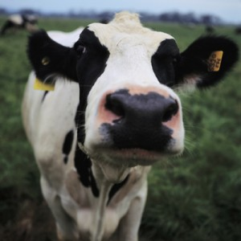
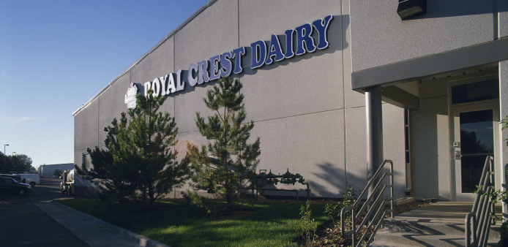
Perishable Products
Must be located near market
Short shelf live/ fast expiration
Bread/Milk
Goes bad within the week or two
Newspaper
Good only for 24 hrs.
“Yesterday’s News!”

Slide 20
Other Important Vocab
Technopole
A region of many high tech businesses (agglomeration)
Silicon Valley, CA
Denver Tech Center (DTC)

