Slide 1
Magic Washing Machine
https://youtu.be/6sqnptxlCcw
Varignon Frame
https://youtu.be/zUQHl4eQGgw

Slide 2
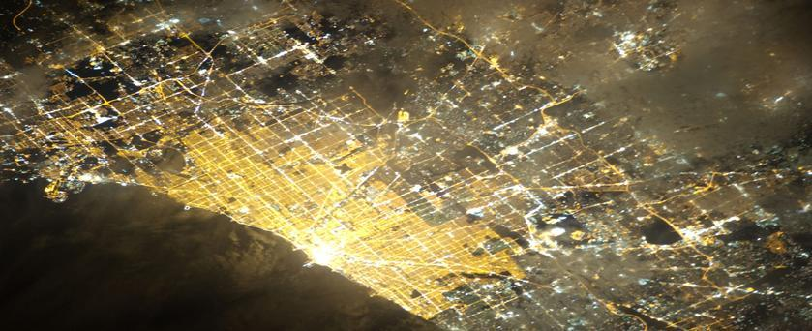
The Geography of Services

Slide 3
What is a service?
Any activity that fulfills a human want or need and returns money to those who provide it.
Tertiary sector of economic activity.
More prevalent in MDCs than LDCs.

Slide 4
So why do geographers care?
Geographers study WHERE services are located.
Services are located where people live in settlements, where people work and live.
Services are located where the people are, the MARKET. “location, location, location”

Slide 5
3 Types of Services Consumer, Business and Public

Slide 6
Consumer Services
Individual consumers who desire them and can afford to pay for them.
retail and wholesale services,
education services
leisure and hospitality services,
health and social services,

Slide 7
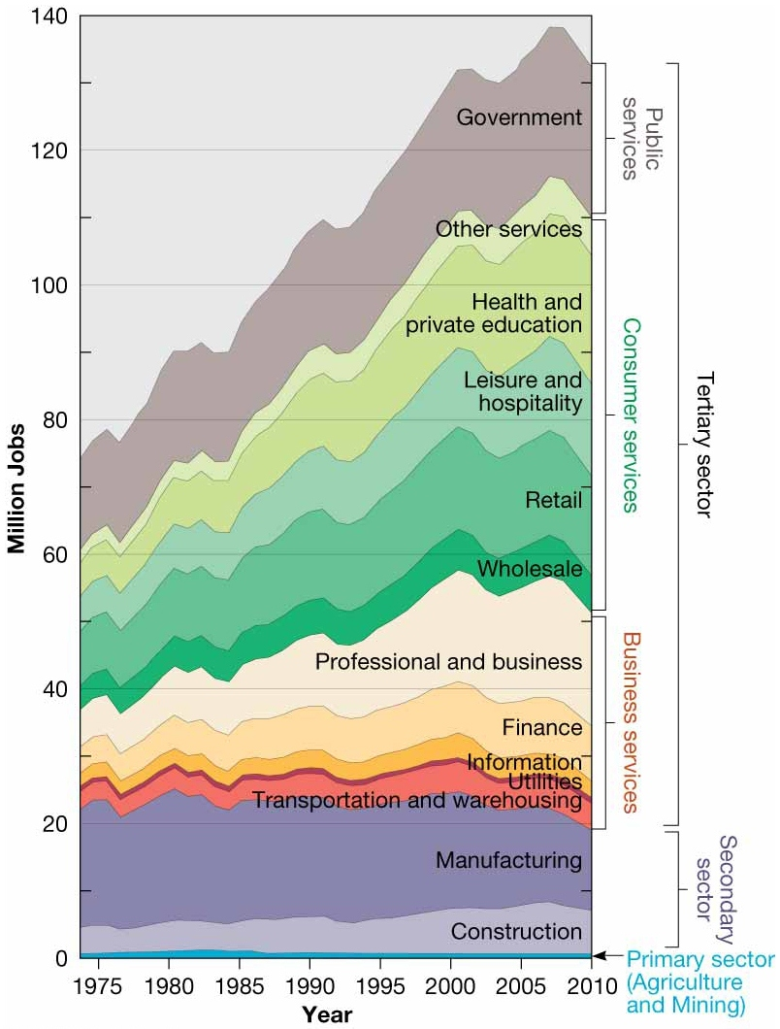

Slide 8
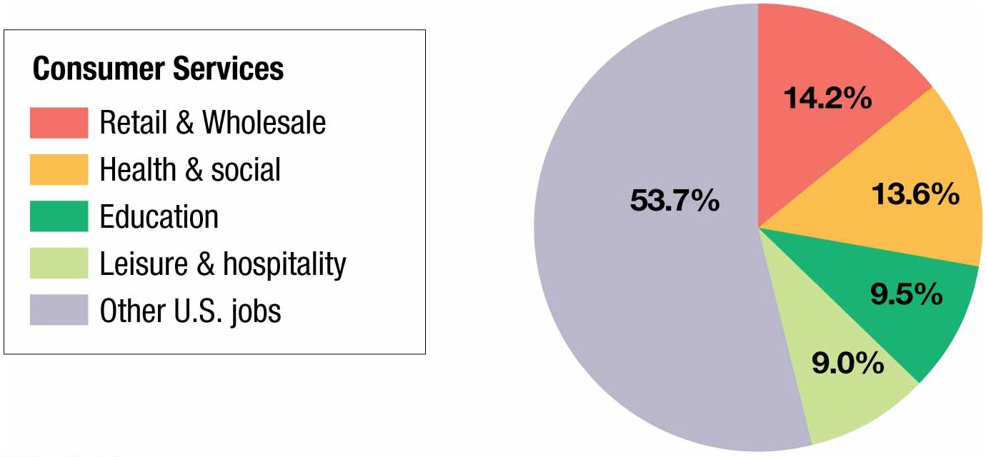

Slide 9
Business Services
to facilitate the activities of other businesses. One-fourth of all jobs in the United States are in business services.
The three main types of business services are transportation and information services, professional services, and financial services.

Slide 10
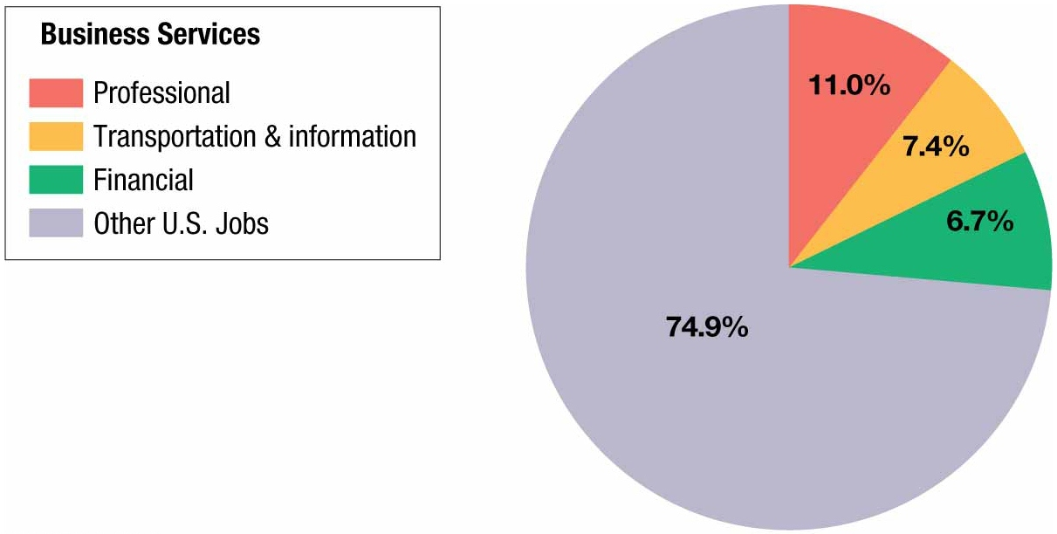

Slide 11
Public Services
Provide security and protection for citizens and businesses.
About 10 percent of all U.S. jobs are in the public sector.
Breakdown: one-sixth of public-sector employees work for the federal government, one-fourth for one of the 50 state governments, and three-fifths for one of the tens of thousands of local governments.

Slide 12
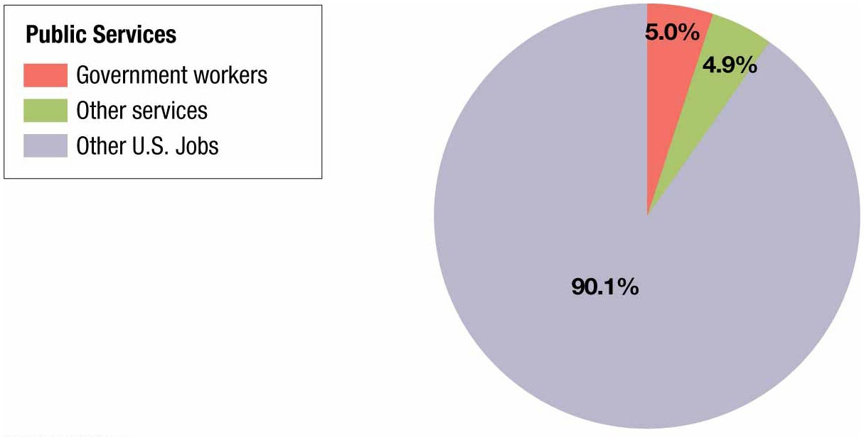

Slide 13
Central Place Theory Walter Christaller
Theory explains how the most profitable location can be identified.
A central place is a market center for the exchange of goods and services.
Businesses in central places compete against each other to serve as markets for goods and services for the surrounding region.
Market area or Hinterland - The area surrounding a service from which customers are attracted
To establish a market area, a circle is drawn around the node of a service on a map. The territory around the circle is its market area.

Slide 14
Market Area or Hinterland
Market area or Hinterland - The area surrounding a service from which customers are attracted
To establish a market area, a circle is drawn around the node of a service on a map. The territory around the circle is its market area.
Market Area

Slide 15
RANGE of Service
Maximum distance people are willing to travel to use a service.
People are willing to go only a short distance for everyday consumer services, such as groceries and pharmacies.
But they will travel longer distances for other services such as a concert or professional ball game.
Therefore, the range of a service must be determined from the radius of a circle that is irregularly shaped rather than perfectly round. The irregularly shaped circle takes in the territory for which the proposed site is closer than competitors’ sites.

Slide 16
THRESHOLD of a Service
The minimum number of people/customers needed to support the service in order to make a profit.
Once the range has been determined, a service provider must determine whether a location is suitable by counting the potential customers inside the irregularly shaped circle.
How expected consumers inside the range are counted depends on the product.
Convenience stores and fast-food restaurants appeal to nearly everyone, whereas other goods and services appeal primarily to certain consumer groups.

Slide 17
Range and Threshold
LOW RANGE and LOW THRESHOLD
HIGH RANGE and HIGH THRESHOLD

Slide 18
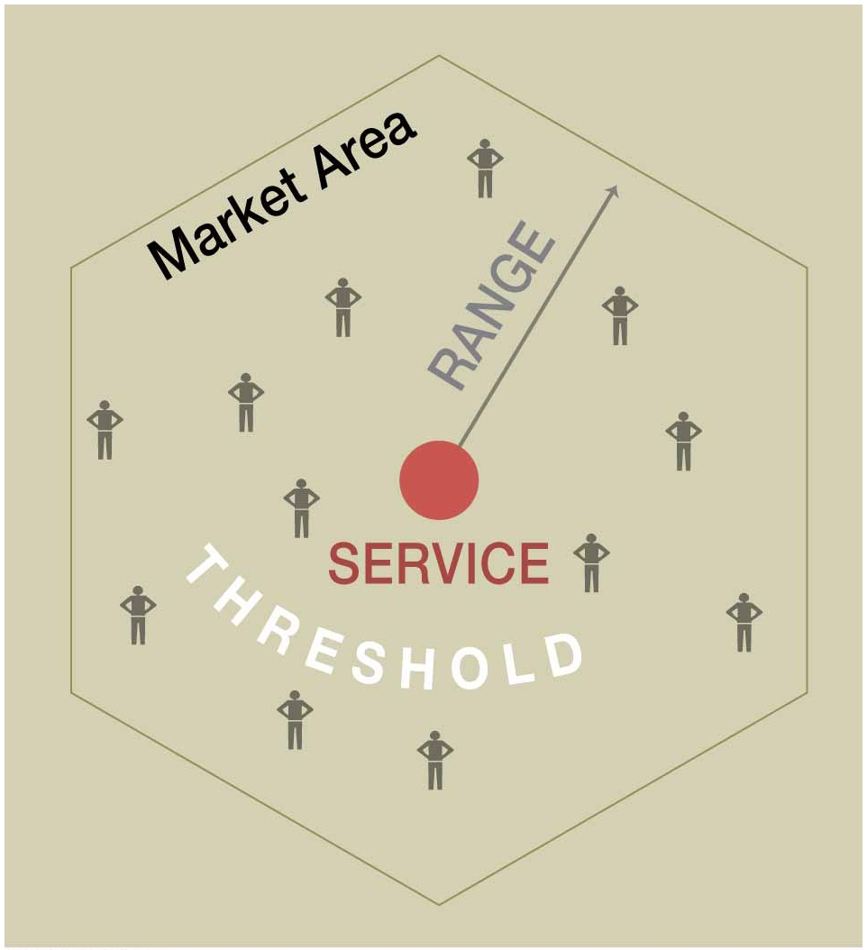

Slide 20
Nesting of Services and Settlements
There are four different levels of a market area:
hamlet, village, town, and city.

Slide 21
Central Place Theory and Settlements
Small settlements have small thresholds (# of consumers).
Larger settlements (Cities) provide more services because they have more people (larger threshold) to support the services.

Slide 22
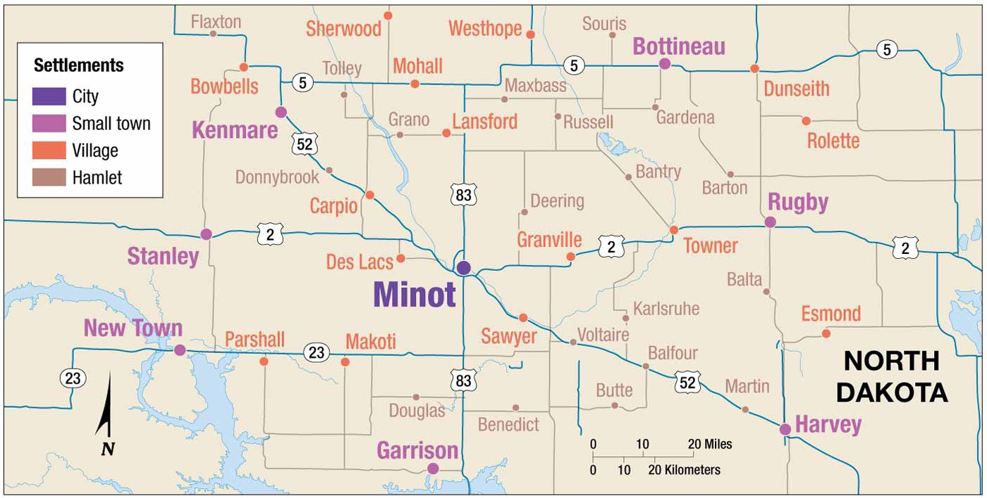

Slide 24
Rank-Size Distribution of Settlements
Developed Countries
The second-largest city is one-half the size of the largest, the fourth-largest city is one-fourth the size of the largest, and so on.
Example: United States

Slide 25
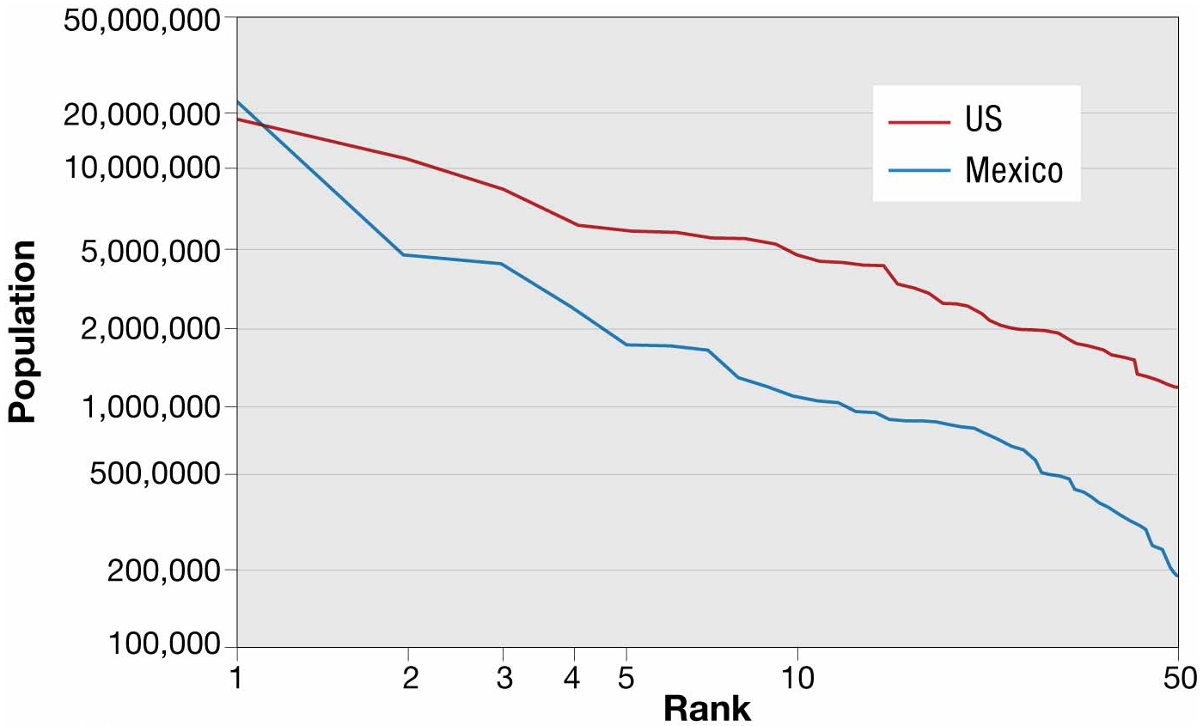

Slide 26
Primate City Rule
If a country does not follow the rank-size rule, it may follow the primate city rule.
The country’s largest settlement (city) has more than twice as many people as the second-ranking settlement.
The absence of rank-size distribution in many developing countries indicates that there is not enough wealth in the society to pay full variety of services.

Slide 27
Many Primate Cities are located in Africa
The absence of rank-size distribution in many developing countries indicates that there is not enough wealth in the society to pay full variety of services.

Slide 28
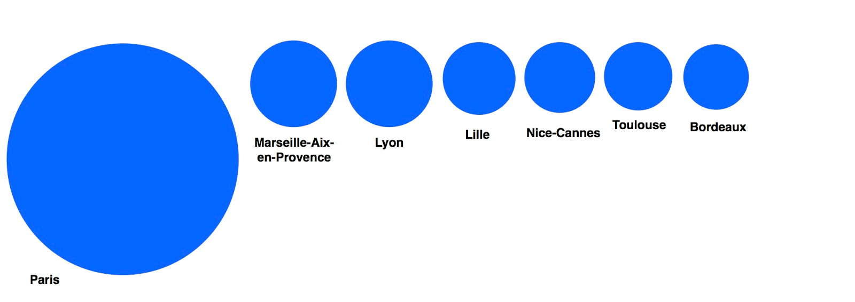
Primate City
Examples in Europe:
Paris, France
Copenhagen, Denmark
London, United Kingdom

Slide 29
WORLD CITIES or Global City
“a global city is a significant production point of specialized financial and producer services that make the globalized economy run”.
Characteristics:
Centers for financial services and headquarters of major banks, insurance companies and transnational corporations.
Home to major stock exchanges
Major center of the arts and culture
Influential in world politics
Large mass transit systems

Slide 30
(1)World Cities
Dominant -Tokyo, London, NYC
Major - Chicago, LA, Paris
Secondary - San Francisco, Mexico, Berlin
(2)Command and Control Centers -(Headquarters of Industries)
(3) Specialized Producer-Service Center -(Specialized activities of specific Industries)
(4) Dependent Centers (Mining, Military, Manufacturing, Resorts, Retirement Community)

Slide 31
Peripheral Services
Offshore Financial Services (Microstates, Dependencies,
Island Countries)
Decrease Taxes
Privacy
Back Offices (increasing in LDC’s)
Business Process Outsourcing

Slide 32
Economic Base of Settlements
Basic Industry (export industries)
+
Non-basic Industries (consumer services)
=
Economic Base
# people in basic industries
% of people in community/% of people in country

Slide 33
Specialization of Cities in Different Services
Durable - steel, automobiles
Non-Durable - textiles, food, paper
Business, Consumer, Public Services
Distribution of Talent (Richard Florida)
^ diversity ^talent
College degree, # of Gays, Cool Factor,
Scientists, Professionals, Cultural Amenities

