Slide 1
Urban Patterns

Slide 2
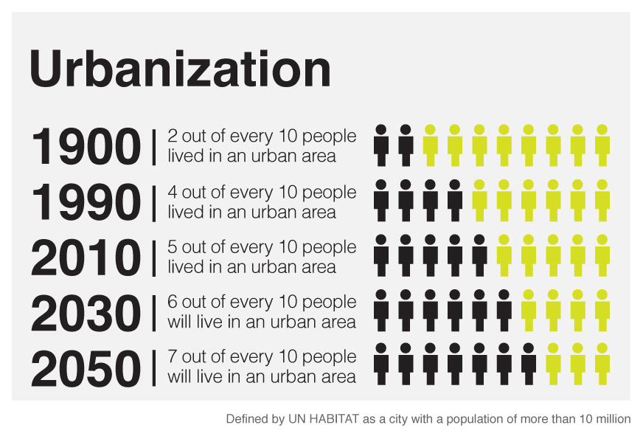
Urbanization
The process by which people live and are employed in a city.

Slide 3
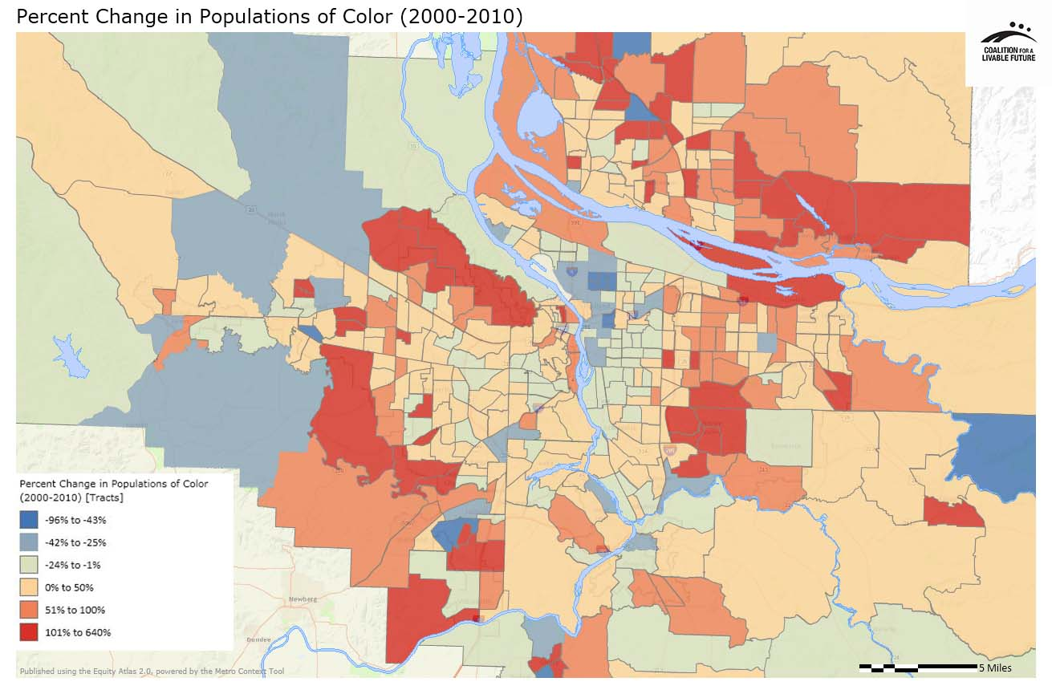
Social Area Analysis
The distribution of different types of people in an urban area. (example of Portland, Oregon)
This map also shows gentrification. What is gentrification???

Slide 4
Cities Throughout History
Ancient Cities : Walled, Temples and Palaces in Middle, settlements surrounding. Graves outside the cities, well planned, narrow passages
City States: Trade oriented, diffused along the Mediterranean
Roman Cities: Connected by roads
Medieval Cities: Walled cities in Europe, supported by surplus from rural areas

Slide 5
The three Urban Land Use Models

Slide 6
Burgess’ Land Use Model/Concentric Zone Developed in the 1920s
As used in urban areas: society within an urban area is often arranged in a series of concentric rings in positions defined by social factors.
The most expensive land is often in the center the city and the land on the edge of the city is cheaper.
Cities grew outwards from the original site so the oldest buildings would be in the middle of the city and the youngest would be on the edge.

Slide 7
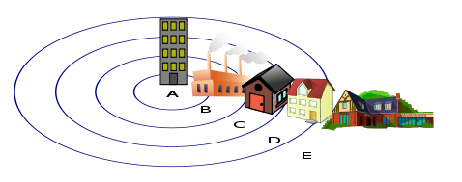
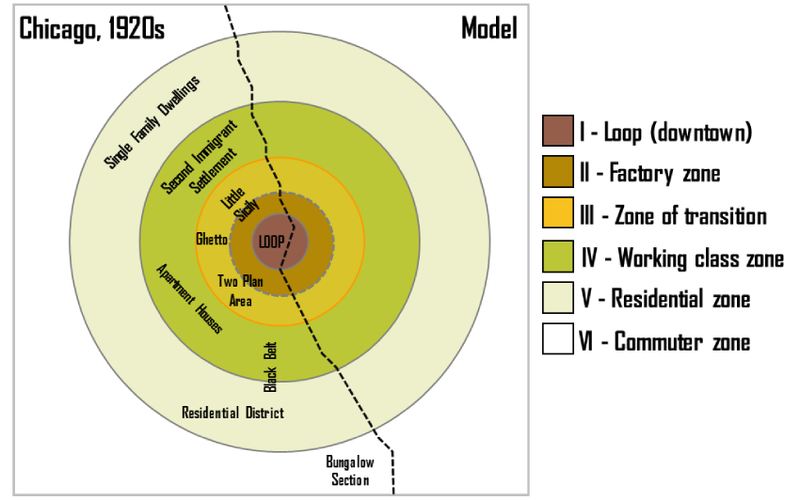
Burgess Model
Central Business District
Zone in transition
Zone of independent workers' homes
Zone of better residences
Commuter's Zone

Slide 8
Limits to the Burgess model
Model was developed before the advent of mass car ownership.
New working and housing trends have emerged since the model was developed. Many people now choose to live and work outside the city on the urban fringe.
Every city is different. There is no such thing as a typical city

Slide 9
Sector Model
Developed by H. Hoyt.
This model assumes the land use is conditioned by transportation routes radiating outward from a city center.
Industrial, retailing, and residential districts extend out from the CBD like wedges.
Hoyt saw the best housing extending north from Chicago along Lake Michigan

Slide 10
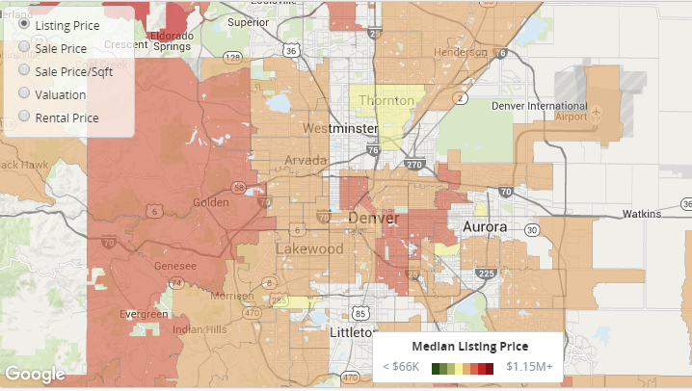
Does Denver follow the Sector Model?

Slide 11
Multiple Nuclei Model
This model assumes that urban areas have more than one focal point influencing land use.
These nuclei most often develop in response to the evolving transportation network. They form, for example, around major highway intersections and surrounding airports.
These multiple nuclei may have arisen in one of two ways:
They were once separate settlements but were absorbed by growth of the urban area.

Slide 12
Multiple - Nuclei Model

Slide 13
Comparing The Latin American City Structure
What are the differences and similarities between the aforementioned models and the Latin American City Structure Model

Slide 14
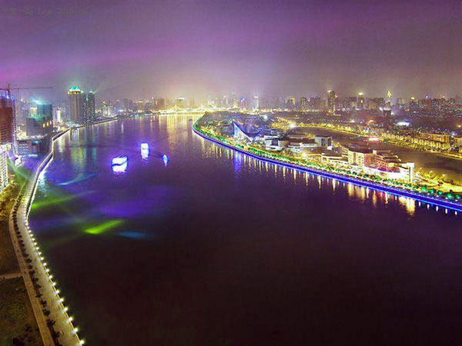
Gateway Cities
Ports of entry and distribution centers for large geographic areas.
Proximity to ports, natural harbors, and raw materials
San Francisco
New York City
Chicago
Guangzhou, China
Cape Town, South Africa
Panama City
Rio de Janeiro, Brazil
Sydney, Australia
Calcutta India

Slide 15
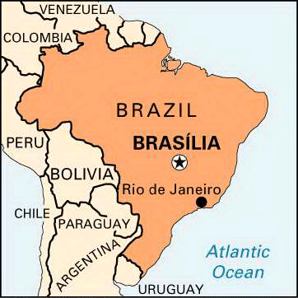
Forward Capital
A capital city placed in a remote or peripheral area for economic, strategic or symbolic reasons.
Examples:
Brazil: Brasilia
Malawi: from Zomba to Lilongwe
Pakistan: from Karachi to Islamabad
Malaysia: from Kuala Lumpur to Putrajaya
Japan: from Kyoto to Tokyo

Slide 16
Urban Sprawl and Edge Cities
Expansive suburban development over large areas in which the automobile is the primary source of transportation.
Edge Cities are located on the outskirts of larger cities.

Slide 17
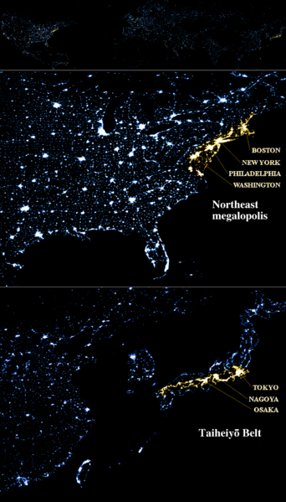
Megalopolis
A entire region in which cities have grown together and has become highly urbanized.
Examples:
-Eastern Seaboard, U.S
-LA-OC-San Diego, Tijuana
-Sao Paulo-Rio de Janeiro-
Brazil
-Tokyo-Osaka Japan

Slide 18
Megacities
Cities with more than 10 million people.
A megacity can be a single metropolitan area or two or more metropolitan areas that converge.
As of 2013, there are 24 megacities in the world
Examples:
Tokyo
Delhi
Mexico City
New York
Shanghai

Slide 19
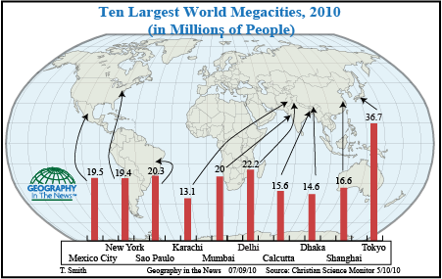

Slide 20
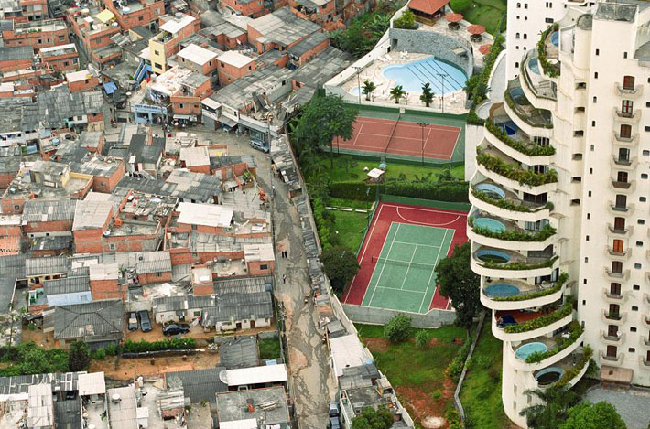
Important Vocabulary
Squatter Settlements
Redlining
Urban renewal
Gentrification

Slide 21
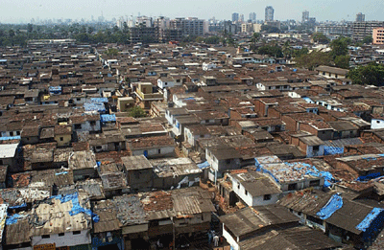
Squatter Settlements

Slide 22
2013 APHG FRQ
#3 Over the past 150 years, railroad and highway systems influenced patterns of urban growth in the United States.
Identify and explain one way that railroads affected the size and one way that railroads affected the form of cities in the United States between 1870 and 1920.
Identify and explain two ways that the Interstate Highway System affected cities in the United States between 1950 and today.

Slide 23
Route 66 Bypassed Radiator Springs

Slide 24
2009
#2. A large proportion of urban residents in the megacities of the periphery of the world system live in squatter settlements.
A. Describe a typical location of squatter settlements within urban areas of megacities on the global periphery.
B. Describe two factors that contribute to the formation of squatter settlements.
C. Give a detailed account of THREE consequences of the rapid growth of squatter settlements. The three consequences you discuss may be social, economic, political or environmental.

