Slide 1
Geography of Ancient Greece
How did Geography impact the Development of the Greek Civilization and Culture?

Slide 2
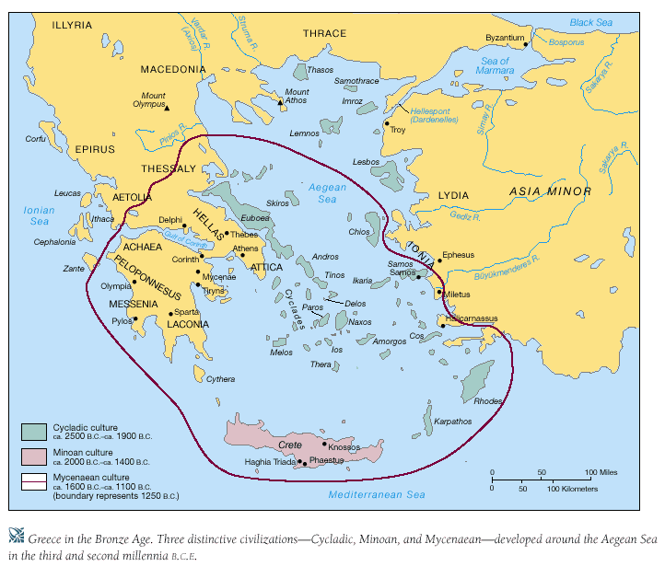

Slide 3
Main Ideas
Rugged mountains divided Greece into many regions.
Difficult to travel
Difficult to create a single government (City-States).
The sea linked the regions of Greece to each other and to foreign regions. Sea trade became common.
Culture -trade helped the early Greeks develop a sophisticated culture.

Slide 4
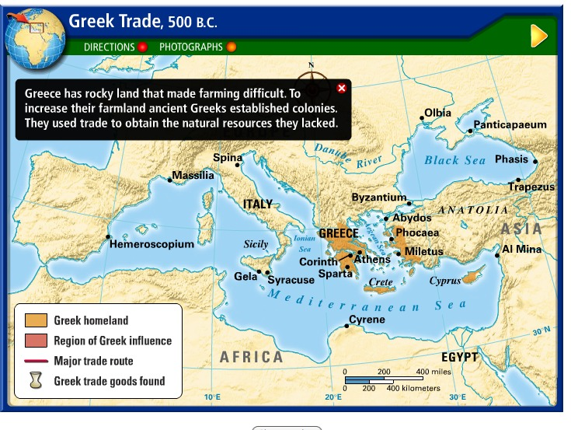

Slide 5
Physical Geography
Southern Balkan Peninsula
Greek mainland is a peninsula—body of land with water on three sides - this peninsula sticks out into Mediterranean Sea - southern tip is a second peninsula called the Peloponnesus - isthmus—narrow strip of land—links Peloponnesus to rest of Greece
Rugged, low mountains (70-80% of the land).
Thousands of islands, great harbors.
Little natural resources

Slide 6
Rugged Mountains

Slide 7
Physical Geography-Climate
Hot summers
Mild rainy winters
Afternoon breezes carry cooler air from the sea to offset the hot, dry summers.
Greeks spent most of their time outdoors.

Slide 8
Physical Geography Southern Greece
Dry, rocky with small plains separated by low mountains ranges.
Not very fertile. Grew olives and grapes
Domesticated sheep and goats.

Slide 9
Physical Geography Northern Greece
More rainfall than Southern Greece
Broader plains where barely could be grown
Horse and cattle could graze.
Thessaly

Slide 10
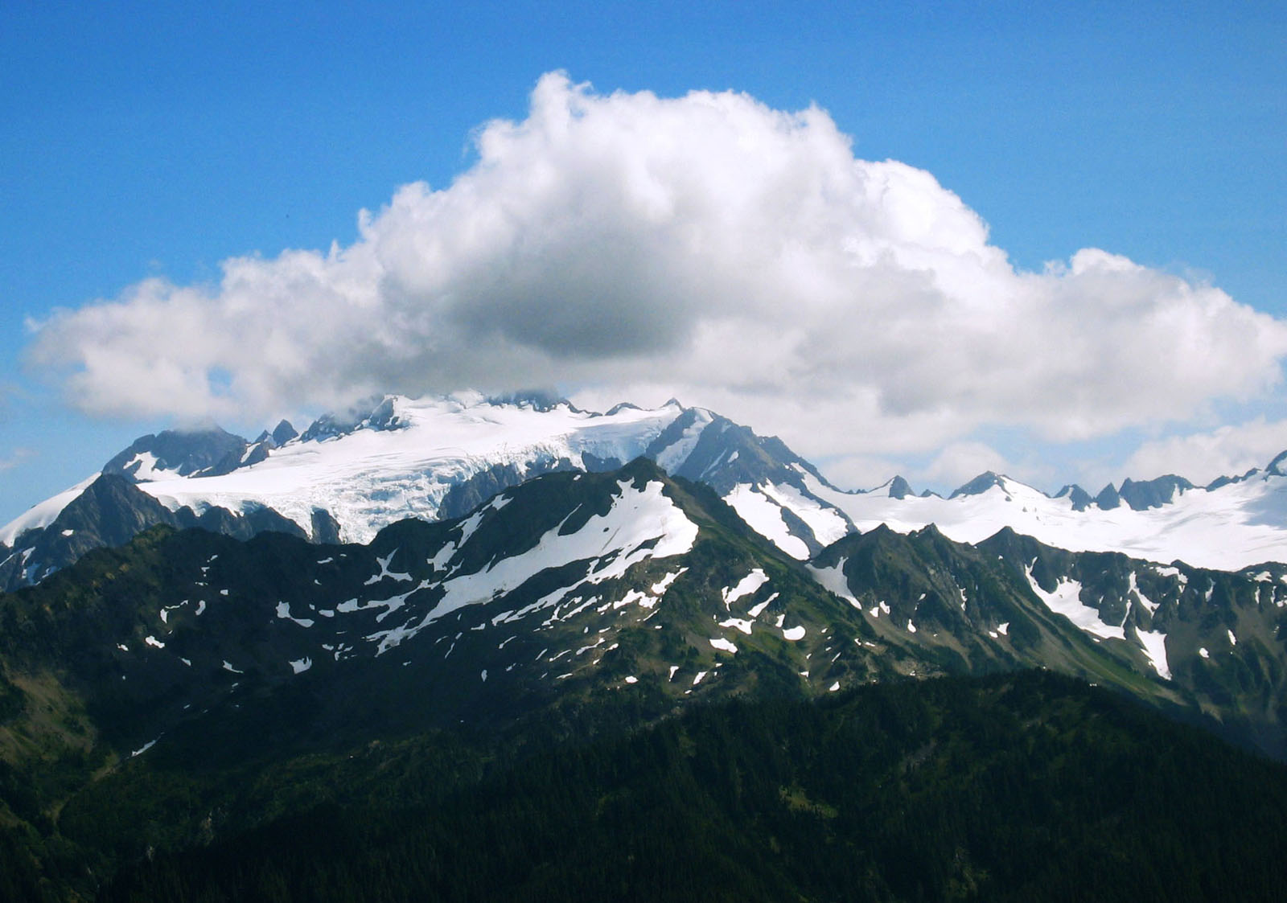
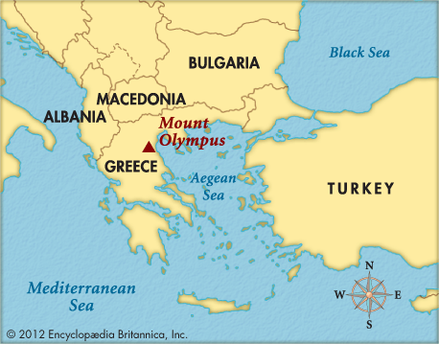
Όλυμπος Mt. Olympus 2,919 m (9,577 ft)

Slide 11
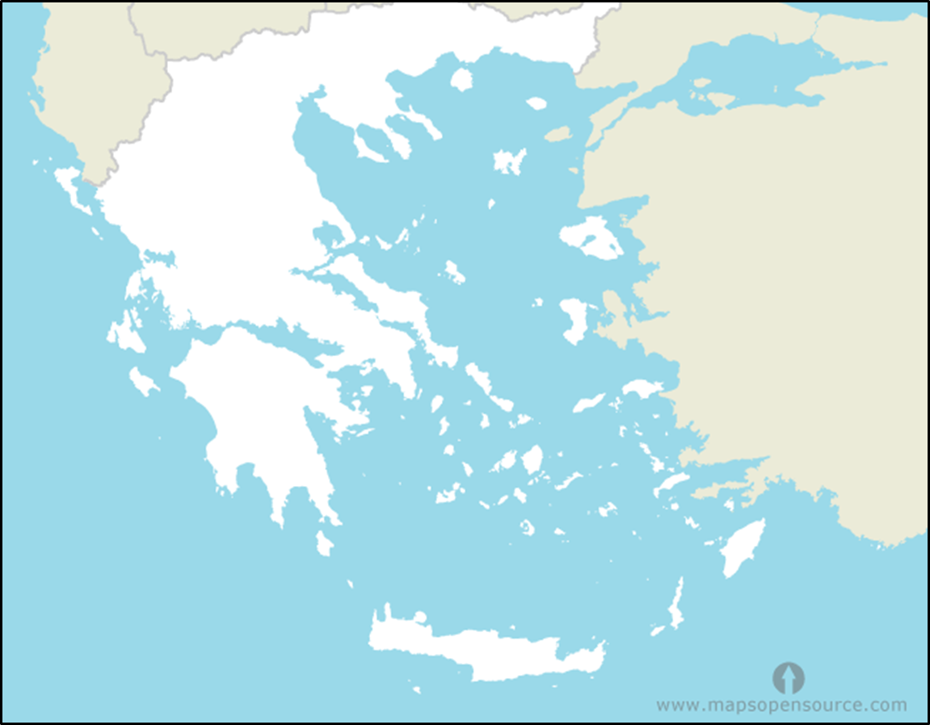
BLACK SEA
Dardanelles>
*Troy
Mt. Olympus●
Asia Minor/Anatolia
Greece
AEGEAN SEA
Thermopylae*
Mt. Parnassus●
*Thebes
*Marathon
Mycenaean
Athens*
Peloponnesus-
The Peloponnesian Peninsula
*Miletus
Sparta*
I o n i a
IONIAN SEA
The Island of Crete
*Knossos
Minoans
M E D I T E R R A N E A N S E A

