Slide 1
Environmental Determinism and Possibilism

Slide 2
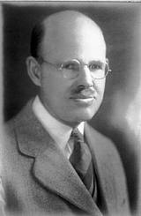
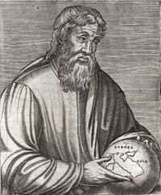
Environmental Determinism
Greek geographer Strabo
Ellsworth Huntington
Social Darwinism
Connection of Climate to Human Behavior
Possibilism
Strabo talked about this as well
Environment does not determine behavior
It may limit human activities and endeavors – not determine
Opportunities and Intelligence

Slide 3
http://www.slideshare.net/deilands/unit-3-cultural-geography

Slide 4
Criticisms of Environmental Determinism
Cultural Ecology - Relationship between culture and the natural environment
Both biological and cultural processes which enable humans to adapt and survive
Cultural Landscape – human material landscape (human imprints) and human ecology. Pays attention to the damaging impacts of humans on the environment.
Carl Sauer
Fierce critic of environmental determinism

Slide 5
Geologic history basics
The geologic eras:
Paleozoic: ? - 220 million years ago
Mesozoic: 220 - 65 million years ago
K/T Boundary – Kretaceous-Tertiary Boundary
Cenozoic: 65 million to present time

Slide 6
Holocene Human Transformation Last 10,000-15,000 years (page 384, 11th ed.)
1. Domestication of plants and animals – allowed humans to settle in a STABLE manner for 1st time
2. Social Stratification – humans begin specializing jobs and activities
3. Changing and controlling the environment – irrigation, dams, farming
Specific of Human effects during HOLOCENE transformation
Farming – transforms the Earth the most terraces, irrigation, canals.
Administration – politics, boundaries, walls, fences, etc. Fences are a statement of culture, law, etc.
Urbanization – rise of towns to cities, cultural differences
Capitalism – money, value, exchange of goods/services.
Industrialization – changed landscape 6,000 years ago expanded use and need of natural resources, mass production
Transportation and Communication – RR, pipelines, power lines, highways, airfields.
Population – biggest change. 6M to 7B. Most happened in last 200 years.

