Slide 1
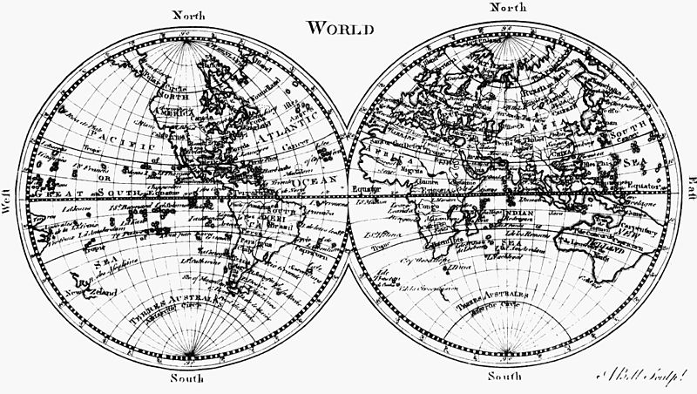
AP Human Geography Review
Part I

Slide 2
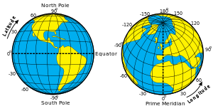
Latitude and Longitude
Know it. This is AP Geography after all…

Slide 3
Know your Political Geography
Where is Namibia?
Where is Georgia? The country.
Where is the former Yugoslavia? What states are there now?

Slide 4
Spatial Perspective
Intellectual framework that looks at the particular locations of specific phenomenon, how and why that phenomenon is where it is, and finally how it is spatially related to phenomena of other places.
Spatial analysis includes any of the technique used to study geographic properties.
Map by Dr. John Snow of London of showing location of cholera cases in the 1845 Cholera outbreak .

Slide 5
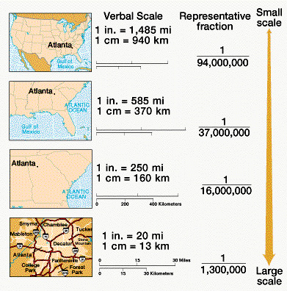
Scale
The relationship between the portion of the Earth being studied and the Earth as a whole.

Slide 6
Projection scientific method of transferring locations on Earth’s surface to a flat map
The shape of an area can be distorted to look elongated or squat than in reality
The distance between two points may become increased or decreased.
The relative size of different areas may be altered (objects are smaller then they appear)
The direction from one place to another can be distorted
Notes:
Every flat map misrepresents the surface of the Earth in some way. No map can rival a globe in truly representing the surface of the entire Earth. However, a map or parts of a map can show one or more—but never all—of the following: True directions. True distances. True areas. True shapes.

Slide 7
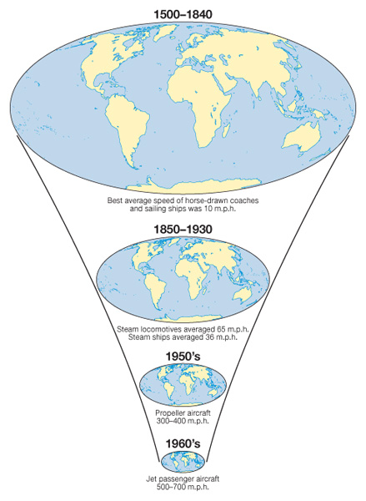
Space-time Compression
The reduction inn the time it takes to diffuse something to a distant place as a result of improved technology and transportation systems.

Slide 8
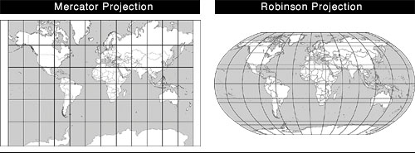
WHAT ARE THE WEAKNESSES OF EACH?

Slide 9
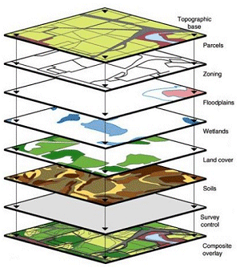
GPS vs. GIS
Geographic Information Systems (GIS): A set of computer tools used to capture, store, transform, analyze and display geographic data
Global Positioning System (GPS): a set of satellites used help determine location anywhere on Earth’s surface with a portable electronic devise

Slide 10
Remote Sensing
The observation and mathematical measurement of Earth’s surface using aircraft and satellites. The sensors include photographic and other types of images.

Slide 11
Relocation Diffusion
Spreading of ideas through physical movement of people from one place to another.
People migrate to other places because of cultural, political, economic, and environmental reasons.
Through migration, they carry with them their culture (language, religion, and ethnicity).

Slide 12
Expansion Diffusion
Spread of a feature from one place to another in a snowballing process.
3 process of expansion diffusion
Hierarchical diffusion-usually results from the spread of ideas from political leaders or other important people in the community. (hip-hop music)
Contagious diffusion-rapid, widespread diffusion of a characteristic throughout the population ( such as disease).
Stimulus diffusion-the spread of an underlying principle, even though a characteristic itself apparently fails to diffuse. (Mac Donald’s menu in China?)

Slide 13
What does it mean when a country has a high physiological density?

Slide 14
Arithmetic Density
The total number of objects in an area, is commonly used to compare the distribution of population in different countries
Physiological Density
The number of persons per unit of area suitable for agriculture.
Agricultural Density
The number of farmers per unit area of farmland

Slide 15
Three Types of Regions
Formal-(or uniform or homogenous region) An area in which everyone shares in one or more distinctive characteristics.
Functional- (or nodal region) An area organized around a node or focal point. Moving away from the nodal point is also distance decay.
Vernacular- (or perpetual region) An area that people believe exists as part of their identity.

Slide 16
Explanation and Examples
Formal Region- any geographic location whose boundaries are clear and whose territory is set. There is no disagreement over the relative area a formal region may occupy. ( a country, county, state, national park, etc.)
Vernacular Region- nonexistent in a literal sense, and the territory it occupies is not clearly defined and dependent solely upon personal view. An example of a vernacular region in the United Sates in particular would be the South. Any given person may have different beliefs of where the South is located and what regions it encompasses.
Functional Region- a region whose territory is organized around something central, such as a newspaper. The distribution of a given local newspaper is limited to a certain area, which is its functional region. Another example would be a fan base for a sports team

Slide 17
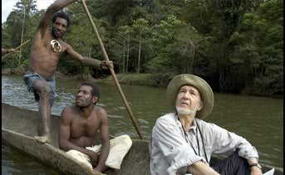
Cultural Ecology
Environmental determinism vs. possibilism

Slide 18
Environmental Determinism
Argued that the general laws sought by human geographers could be found in the physical sciences.
German geographers Alexander von Humboldt and Carl Ritter claimed that cultural traits are formed and controlled by environmental conditions.
Example: Certain types of people who came from cultures that arose in certain physical environments may be smarter and more successful in creating “civilized” societies. This justified a racist colonization of native peoples in Africa, South America etc. because the people who lived in those hot, muggy, and oppressive environments were deemed less and intelligent and industrious
Motivation for colonial exploits?

Slide 19
Possibilism
The physical environment may limit some human actions, but people have the ability to adjust to their environment
People can choose a course of action from many alternatives in the physical environment.
Ex: the climate of any location influences human activities, especially food production.
It is possible for people to choose the crops they grow and to be compatible with their environment

Slide 20
KÖppen System-Climate Regions
Divides the world into five main climate regions-
A - Tropical Climates
B - Dry Climates (subdivision is on the basis of
temperature and precipitation)
C- Warm Mid-Latitude Climates
D - Cold Mid-Latitude Climates
E - Polar Climates

Slide 21
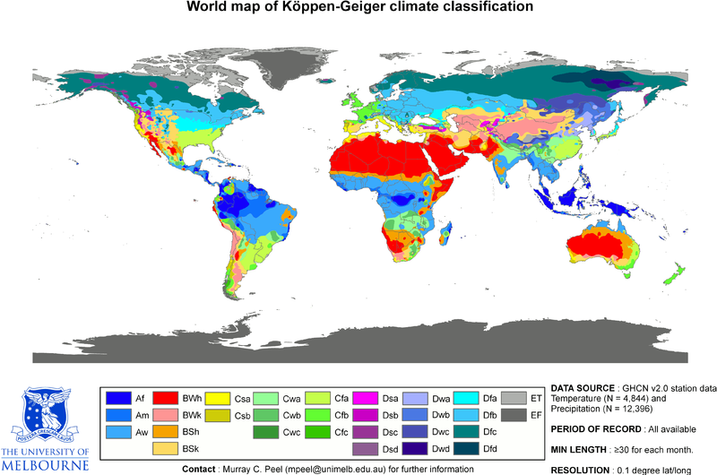

Slide 22
Biomes
Four major forms of plant communities are called biomes (influenced by both climate and human activities).
4 main biomes
Forest- trees form a continuous canopy over the ground.
Savanna- a mixture of trees and grasses.
Grassland- covered by grass rather than trees.
Desert- not completely bereft of vegetation

Slide 23
Demographic Transition Model

Slide 24
Population and British Economist Thomas Malthus
Late 1700s in context of the industrial revolution. Population was growing at a faster rate than agriculture productivity.
Coined the term overpopulation.
Correct in that the world population would grow exponentially.
Wrong in that he could have never predicted the inventions of the agricultural revolutions.

Slide 25
Epidemiological Transition
Stage 1: Plagues, pestilence, famine, Black Plague
Stage 2: Receding Pandemics (disease that occurs over a wide geographic area and affects a very high proportion of the population) due to Industrial Revolution (improved sanitation, nutrition, medicine) - Cholera and Dr. John Snow
Stage 3: Stage of degenerative and human created diseases (heart attacks, cancer, cardiovascular)
Stage 4: Delayed degenerative diseases due to operations, medicine, reduce tobacco and alcohol, better info, more education multi-media, exercise
Stage 5: Reemergence of infectious and parasitic diseases. Evolution of microbes that cannot be destroyed by medicine. Poverty causes infectious diseases. Improved travel spreads microbes all over the world. AIDS. Societies could revert back to Stage 1.

Slide 26
New term to remember!!!
demographic momentum: the term that describes the concept that population will continue to grow even after fertility rates decline.

Slide 27
Lee’s Push Pull Model of Migration
Push Factors
Cultural (wars, persecution). Refugees.
Physical or environmental (flooding, drought, natural disasters)
Pull Factors
Political (lure of freedom, democracy)
Economic (perceived opportunities for jobs)
Physical (lure of attractive climate and landform features)

Slide 28
Zelinsky's Migration Transition Model
Stage One: Hunters and gatherers move from one place to another for survival. High CBR and CDR and low NIR. Search for local food rather than permanent migration to a new place.
Stage Two: High NIR because of rapidly declining CDR. Point when international migration becomes especially important. Interregional migration from one's country's rural areas to its cities. Improvement in agricultural practices reduces the number of people needed in rural areas, and jobs in factories attract migrants to the cities in another region of the same country or in another country.
Stage Three and Stage Four: Internal migration is more important. Moderating NIR because of rapidly declining CBR. The principal destinations of the international migrants leaving the stage 2 countries in search of economic opportunities. The principal form of internal migration within countries in stages 3 and 3 is intraregional, from cities to surrounding suburbs.

Slide 29
Gravity Models
Gravity Model of Migration
When applied to migration, larger places attract more emigrants than do smaller places. Additionally, destinations that are more distance have a weaker pull (distance decay) than do closer opportunities of the same caliber.
Gravity Model of Population
The gravity model takes into account the population size of two places and their distance. Since larger places attract people, ideas, and products more than smaller places and places closer together have a greater attraction, the gravity model incorporates these 2 features.

Slide 31
Language Tree
Language: A system of communication through the use of speech, a collection of sounds understood by a group of people to have the same meaning.
Language Family: A collection of languages related to each other through a common ancestor long before recorded history.
Language Branch: A collection of languages related through a common ancestor that existed several thousand years ago. Differences are not as extensive or as old as with language families, and archaeological evidence can confirm that branches derived from the same family.
Language Group: A collection of languages within a branch that share a common origin in the relatively recent past and display relatively few differences in grammar and vocabulary.

Slide 32
Folk vs. Pop Culture
Folk Culture
Popular Culture
Rural people who live in a old fashioned way-holding a lifestyle less influenced by modern technology.
Folk Geography-the study of the spatial patterns and ecology of these tradition groups.
The entirety of ideas, perspectives, attitudes and ideas that are the mainstream of a given culture.
Heavily influenced by mass media.

Slide 33
Impacts of the Globalization of Popular Culture
Threats to folk culture
Loss of traditional values
Foreign media dominance
Environmental impacts of popular culture
Modifying nature
Uniform landscapes
Negative environmental impact

Slide 35
Types of World Religions
Universal Religions
Ethnic Religions
Try to universally appeal to all people regardless of geography
Examples: Christianity, Islam and Buddhism
Universalizing religions are broken up into Branches, denominations and sects. (next slide)
Appeal to one group, perhaps an ethnic group, living in one geographic place.
Examples: Hindu, Daoism, Confucianism, Shinto, Judaism, Animism

Slide 36
Sequent Occupance
The notion that successive societies leave their cultural imprints on a place, each contributing to the cumulative cultural landscape.

