Slide 1
AP Human Geography Review
Part II

Slide 2
Political Geography
a branch of human geography that deals with governments, boundaries and subdivisions of political units (as nations or states), and the situations of cities.

Slide 3
Colonialism
Colonialism
The effort by one country to establish settlements in a territory and to impose its political, economic and cultural principles on that territory. Began in the 1400s.

Slide 4
Imperialism
Imperialism:
Control of a territory already occupied and organized by an indigenous society.
Types: Economic Imperialism, Sphere of Influence or protectorate

Slide 5
Berlin Conference 1884-85
The western powers of the world met in Berlin, Germany to negotiate questions and end confusion over the control of Africa.
At the time 80% remained under traditional and local control.
Europeans drew up Geometric boundaries that divided Africa into fifty irregular countries. This new map of the continent was superimposed over the one thousand indigenous cultures and regions of Africa.
No African leaders were invited to attend

Slide 6
Before and After the Berlin Conference

Slide 7
Nation vs. State
Nation
State
Community of people who share a common language, culture, ethnicity, or religion. Nation does not have to have political borders.
An area recognized into a political unit and ruled by an established government with control over its internal and foreign affairs

Slide 8
Types of States
Multiethnic state: State that contains more than one ethnicity. USA is the best example.
Multinational state: contains two ethnic groups or more with traditions of self-determination that agree to coexist peacefully by recognizing each other as distinct nations. Russia is the largest. United Kingdom: Wales, Scotland, Ireland
Nation-state: state whose territory corresponds to that occupied by a particular ethnicity that has been transformed into a nationality. Denmark, Slovenia, Germany

Slide 9
Shapes of Countries AP Human Geography
Compact: distance from geometric center is similar (e.g., Germany, Hungary,…)
Elongated: (e.g., Chile, Vietnam,…)
Fragmented: two or more separate pieces (e.g., Indonesia, Philippines,…)
Perforated: territory completely surrounds that of another state (e.g., Italy, Azerbaijan,… South Africa with Lesotho and Swaziland)
Prorupted: a.k.a. prorupt; have an area that extends from a more compact core (e.g, Thailand, India,…)

Slide 10
Balkanization and Ethnic Cleansing.
Balkanization: The political term used when referring to the fragmentation or breakup of a region or country into smaller regions or countries. The term comes from the Balkan wars, where the country of Yugoslavia was broken up in to six countries between 1989 and 1992.
Ethnic cleansing: Process in which a more powerful ethnic group forcibly removes a less powerful one in order to create an ethnically homogeneous region. Example: Serbia and Bosnia-Herzegovina.

Slide 11
Devolution
process whereby regions within a state demand and gain political strength and growing autonomy at the expense of the central government (e.g., Basque and Catalonia in Spain, Chechnya in Russia, …).
Process by which the central governments delegate statutory powers to lower levels of government, such as state and county

Slide 13
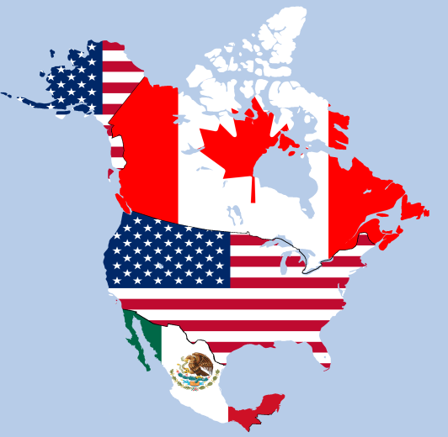
Supranationalism
Political, economic, and/or cultural cooperation among states to promote shared objectives. Tendency for states to give up some political power to higher authority in pursuit of common objectives (political, economic, Military, environmental).
Examples: European Union, NAFTA, Warsaw Pact, League of Nations, United Nations, NATO, OPEC, etc.

Slide 14
Development

Slide 15
The Human Development Index
One Economic factor: Gross National Income per Capita
Two Knowledge factors: Mean years of schooling and expected amount of education for children
One Health factor: Life expectancy

Slide 17
World Systems Theory Immanuel WallersteiN
The economic world is explained through the emergence of a core, periphery a semi-periphery system. The system was established in the 15th Century with the age of exploration when countries began to connect political and economically with each other.

Slide 18
The world is a capitalist system of interlocking states.
Global Economic Core: industrialized, developed countries that drive global economy
Periphery: countries that are underdeveloped and were, usually, once colonies.
Semi periphery: countries that are between core and periphery

Slide 19
Economic Activities
Primary
Raw Materials: Agriculture, mining, fishing, and forestry
Secondary
Manufacturing: capital (for industry) and consumer goods
Tertiary
Consumer: retail and personal services; entertainment
Quatrinary
Business/Producer services: trade, insurance, banking, advertising, transportation and information services
Quinary
Public (government) Services: health, education, research, transportation, tourism & recreation
These three levels are often subdivided within the economic activity group “tertiary” as services may be utilized by both consumers & producers.

Slide 20
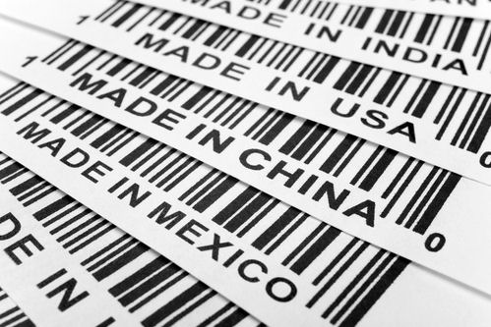
Theories on Development
Self-Sufficiency vs. International Trade

Slide 21
Self-Sufficiency
Pros:
Helps a fragile business by protecting them from large international corporations.
Cons:
Protectionist measures like tariffs, quotas and licenses tend to bring down the quality and speed of production/
A country with a lot of protectionist measures also has a large complex administrative job.

Slide 22
International Trade
Globalization
Increasing interconnectedness and spatial interaction among governments, cultures and economies.
World Trade

Slide 23
World Trade Organization (WTO)
GOALS: Reduction in trade restrictions (tariffs, quotas and licenses) FREE TRADE!
Reduction of restrictions on the international movement of money by banks, cooperation's and wealthy people.
Settles disputes over International Trade.

Slide 24
Gender and Development
Gender –related Development Index
Gender Empowerment
Economic indicator of gender differences
Social indicators of gender differences
Demographic indicator of gender differences
Economic indicators of empowerment
Political indicators of empowerment

Slide 25
Agriculture

Slide 26
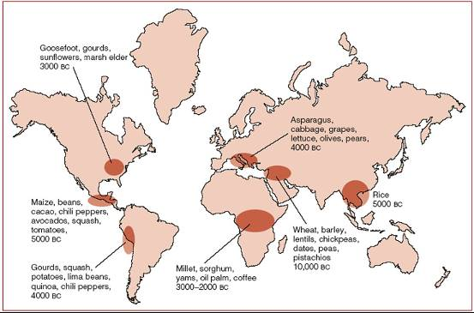
Theories on the origins of Agriculture
Vegetative planting
Cutting off the a stem of another plant or by dividing up roots of a plant.
Seed agriculture:
Farming through the planting of seeds rather than planting part of the parent plant

Slide 27
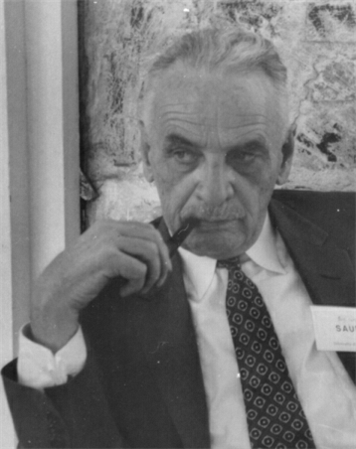
Carl Sauer (1889-1975) Theory of Vegetative Hearth
American Geographer and professor at Berkeley
Was a forerunner in cultural geography and the concept of the “cultural landscape”
Wrote: Agricultural Origins and Dispersals (1952).
Agriculture probably did not originate in one location, but began in multiple, independent hearths, or points of origin. From these hearths agricultural practices diffused across Earth’s surface.

Slide 28
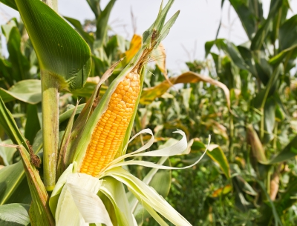
Difference between Subsistence and Commercial Agriculture?
What is the purpose of the farming?
What percentage of farmers are in the labor force?
Is there use of machinery?
How big is the farm?
Is there are relationship to the farm and another business?

Slide 29
Classifying Agricultural Regions
Subsistence agriculture is the production of food primarily for consumption by the farmer’s family
Commercial agriculture is the production of food primarily for sale off the farm
Practice | Purpose | Labor force | Machinery | Farm size | Off farm contact
Subsistence agriculture LDCs | Personal consumption | On average 55% of workforce engaged in farming | Human and animal powered tools | Very small | Occasional surplus sold
Commercial agriculture MDCs | Grow crops and raise animals primarily for sale off the farm for profit | On average 5% of workforce engaged in farming | Mechanized farm machines, computer technology and science | Large [US average in 2008 = 418 acres] | agribusiness – farms one part of a large food production industry including food processing, packaging, sorting, distributing, and retailing

Slide 30
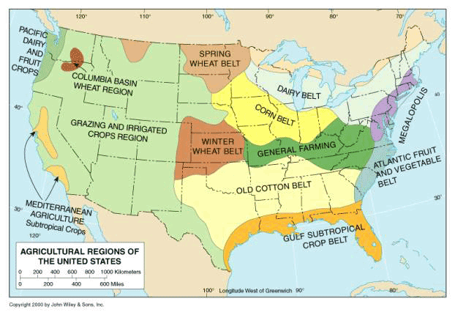

Slide 31
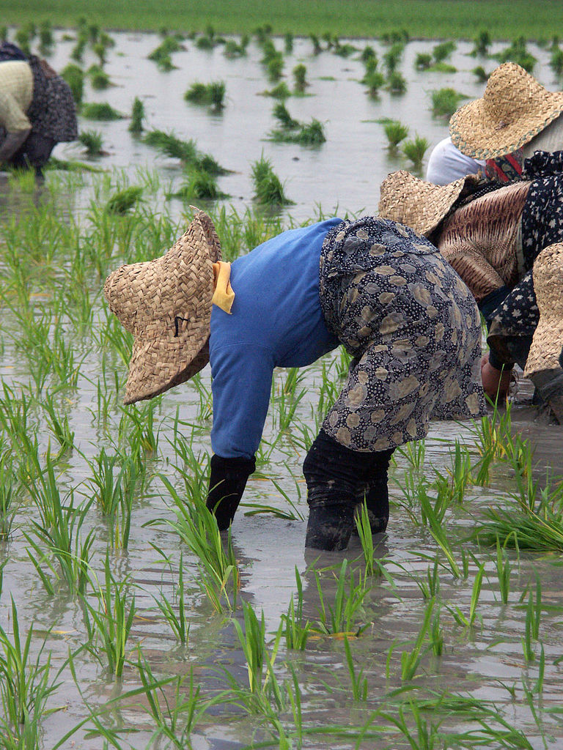
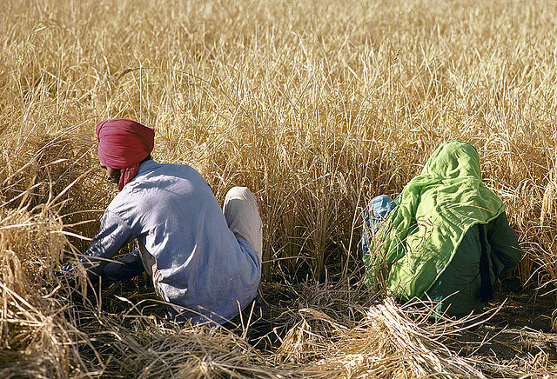
LDCs
Intensive subsistence agriculture
Intensive subsistence with wet rice dominant
Intensive subsistence with wet rice not dominant

Slide 32
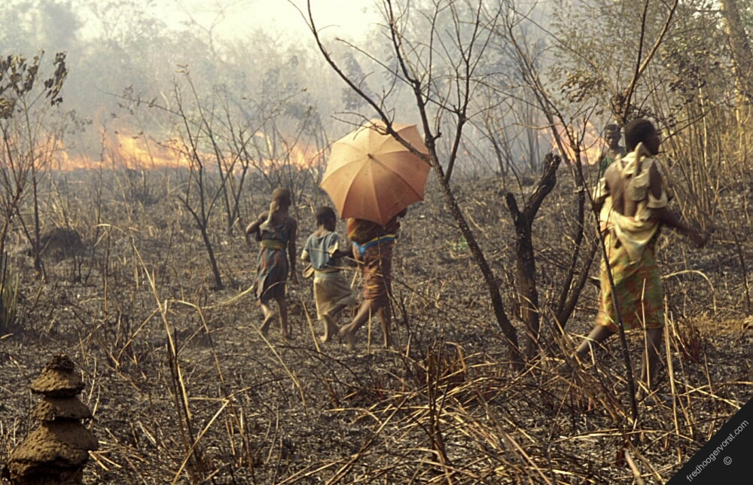
LDCs Shifting Agriculture
Clearing land for planting by slashing vegetation and burning what is left of the debris. The ash has nutrients that are good for crops.
Cleared field is only useful for a few years and then is left fallow for several years until soil recovers.
Crops for shifting Cultivation:
-rice (Asia)
-maize and cassava (S. America)
-millet and sorghum (Africa)

Slide 33
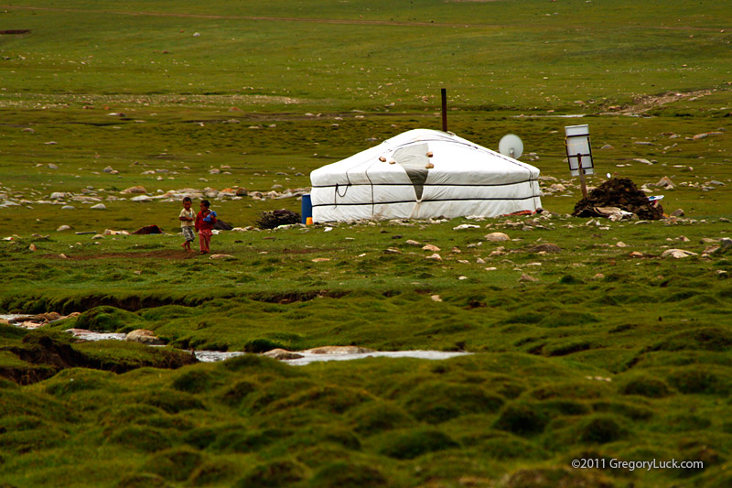
LDCs
Pastoral nomadism
Herding of domesticated animals for the use of their skins, and milk. Nomads are grain eaters who do not actually eat the meat of their herds.
Only about 15 million people are pastoral nomads

Slide 34
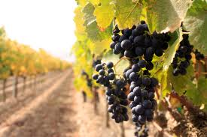
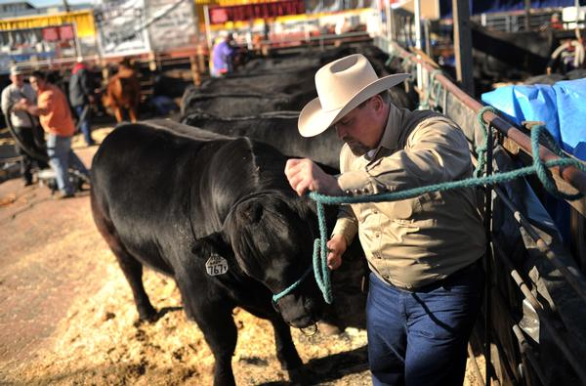
Agriculture MDCs
Mixed crop and livestock systems
Dairy farming
Grain farming
Livestock ranching
Mediterranean agriculture
Commercial gardening and fruit farming
Plantation farming

Slide 35
First Agricultural Revolution Neolithic revolution
First agriculturalists lived in villages and communally worked the land. Very labor intensive.
Around 6000 yrs ago, some villages were able to create a surplus (Nile River Valley, Fertile Crescent, Yangzi River).
Surplus population growth, more people needed more food, and growing more food required more labor in self-perpetuating cycles of population growth.
Along with this plant domestication came animal domestication.

Slide 36
Second Agricultural Revolution
Enclosure vs. Open-lot System
Connections between the industrial revolution and the second agricultural revolution.
fields doubled or tripled in size with same amount of labor.
Productivity increased and lead to an increase in population.

Slide 37
Third Agricultural Revolution/Green Revolution
Beginning in the 1940s, it developed new strains of hybrid seeds, fertilizers and pesticides that dramatically increased the crop output possible on every farm. Also, this series of events resulted in the creation of a global market for agricultural products

Slide 38
Modern location economics began with Von Thunen (1826).
First to develop a basic model of the relationships between markets, production, and distance.
The costs of transporting different agricultural goods to the central market determines the type of land usage.
Less transportation cost will increase profit.
Since gardening and dairy farming are time sensitive and expensive to ship, they will most likely be closest to the market.

Slide 39
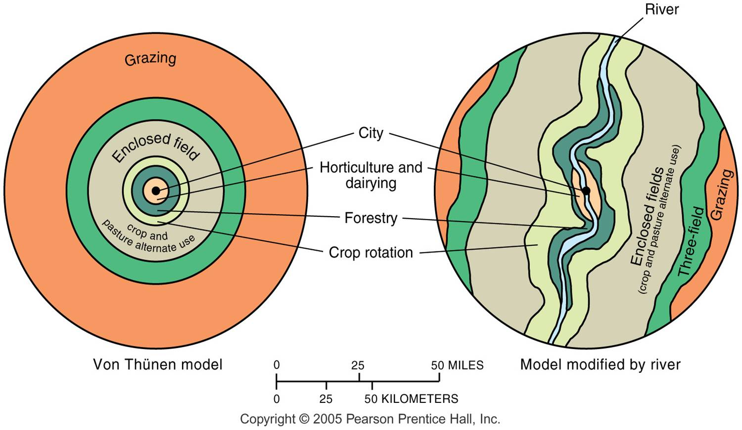
Von Thünen Model

Slide 40
Review Part II COMING SOON!
Industry
Cities and Urban Land Use

