Slide 1
The French Revolution
© Student Handouts, Inc.
www.studenthandouts.com
Notes:
‹#›

Slide 2
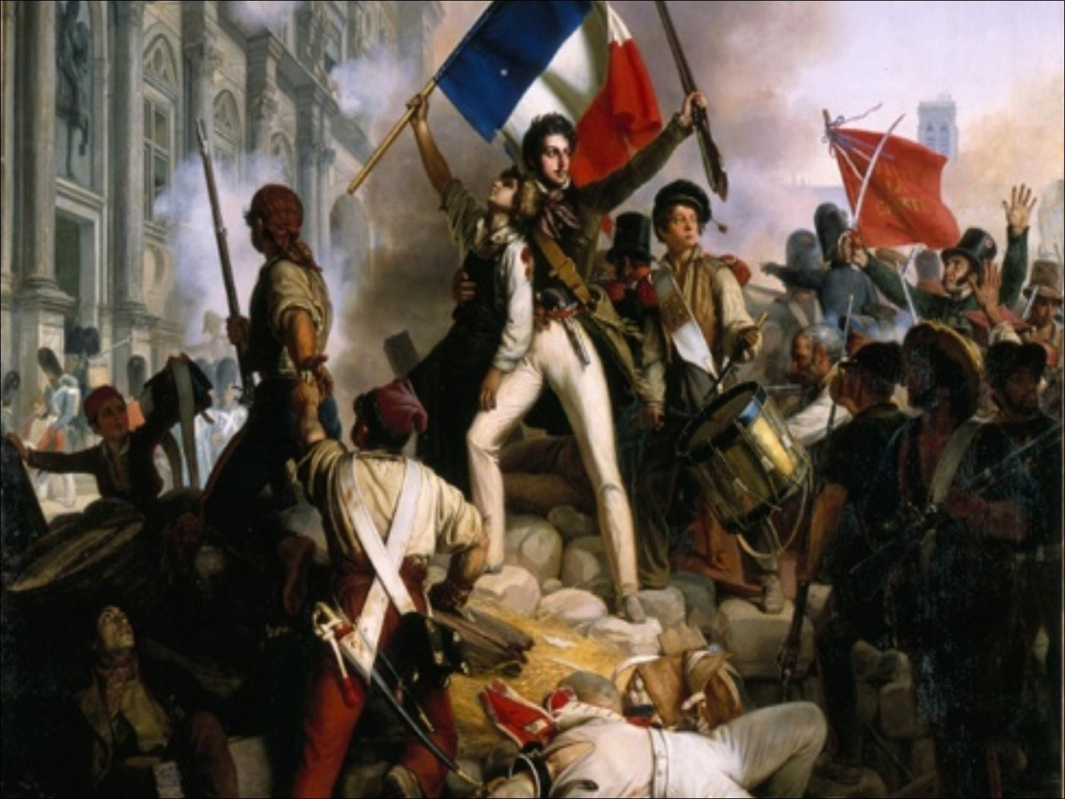

Slide 3
The Old Regime (Ancien Regime)
absolutism of Monarch
Divine Right
Classes of people
Unprivileged people
Merchants, artisans, peasants
Privileged people – did not pay taxes and treated well
Nobles, aristocrats
Clergy

Slide 4
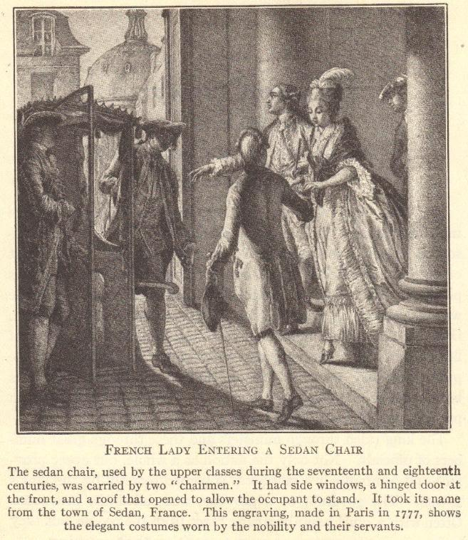

Slide 5
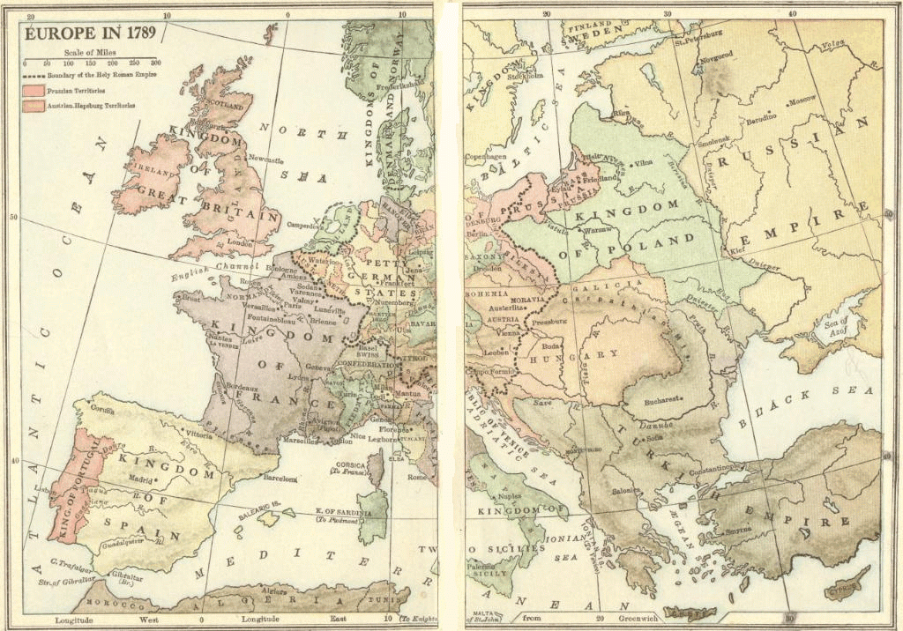

Slide 6
Society under the Old Regime
In France, people were divided into three estates
First Estate
High-ranking members of the Church
Privileged class
Second Estate
Nobility
Privileged class
Third Estate
Everyone else – from peasants in the countryside to wealthy bourgeoisie merchants in the cities
Unprivileged class

Slide 7
The Three Estates
Estate | Population | Privileges | Exemptions | Burdens
First | Circa 130,000 High-ranking clergy | Collected the tithe Censorship of the press Control of education Kept records of births, deaths, marriages, etc. Catholic faith held honored position of being the state religion (practiced by monarch and nobility) Owned 20% of the land | Paid no taxes Subject to Church law rather than civil law | Moral obligation (rather than legal obligation) to assist the poor and needy Support the monarchy and Old Regime
Second | Circa 110,000 Nobles | Collected taxes in the form of feudal dues Monopolized military and state appointments Owned 20% of the land | Paid no taxes | Support the monarchy and Old Regime
Third | Circa 25,000,000 Everyone else: artisans, bourgeoisie, city workers, merchants, peasants, etc., along with many parish priests | None | None | Paid all taxes Tithe (Church tax) Octrot (tax on goods brought into cities) Corvée (forced road work) Capitation (poll tax) Vingtiéme (income tax) Gabelle (salt tax) Taille (land tax) Feudal dues for use of local manor’s winepress, oven, etc.

Slide 8
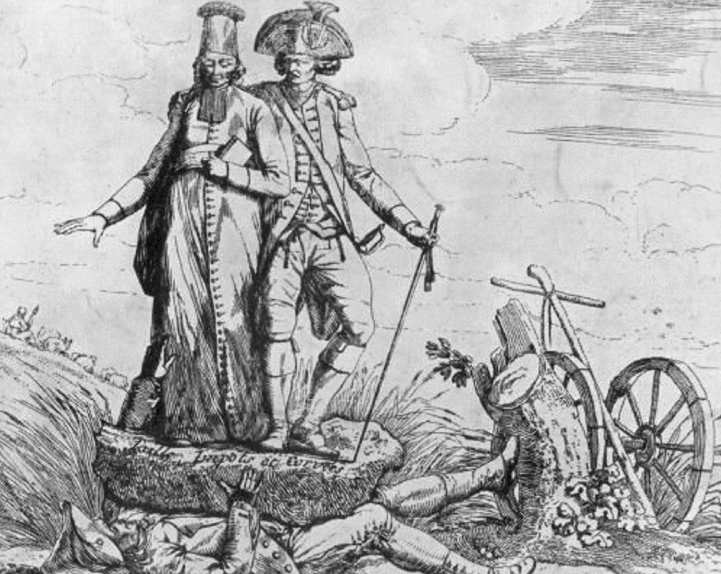
What does this contemporary political cartoon say about conditions in France under the Old Regime?

Slide 9
Government under the Old Regime: The Divine Right of Kings
Monarch ruled by divine right
God put the world in motion
God put some people in positions of power
Power is given by God
No one can question God
No one can question someone put in power by God
Questioning the monarchy was blasphemy because it meant questioning God

Slide 10
King’s prerogative

Slide 11
Economic Conditions under the Old Regime
economy based primarily on agriculture
Peasant farmers bore burden of taxation
Poor harvests meant peasants had trouble paying their taxes
Certainly could not afford to have their taxes raised
Bourgeoisie often managed to gather wealth
upset they paid taxes while nobles did not

Slide 12
France Is Bankrupt
The king (Louis XVI) lavished money on himself and residences like Versailles
Queen Marie Antoinette- a wasteful spender?
Government funds depleted as a result of wars
Including the funding of the American Revolution
Deficit spending – a government spending more money than it takes in from tax revenues
Privileged classes would not submit to being taxed

Slide 13
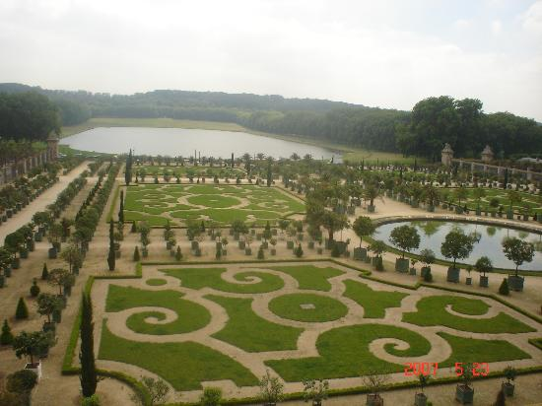

Slide 14
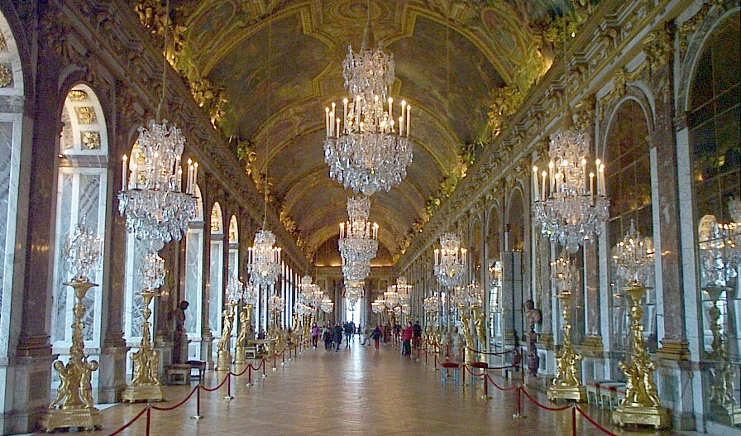

Slide 15
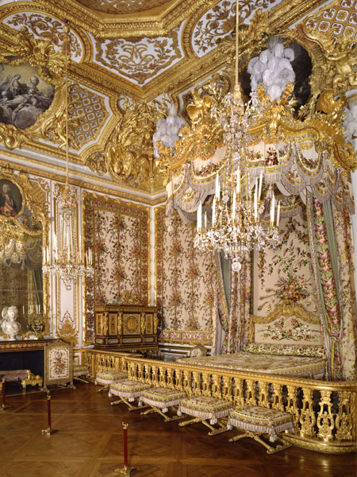

Slide 16
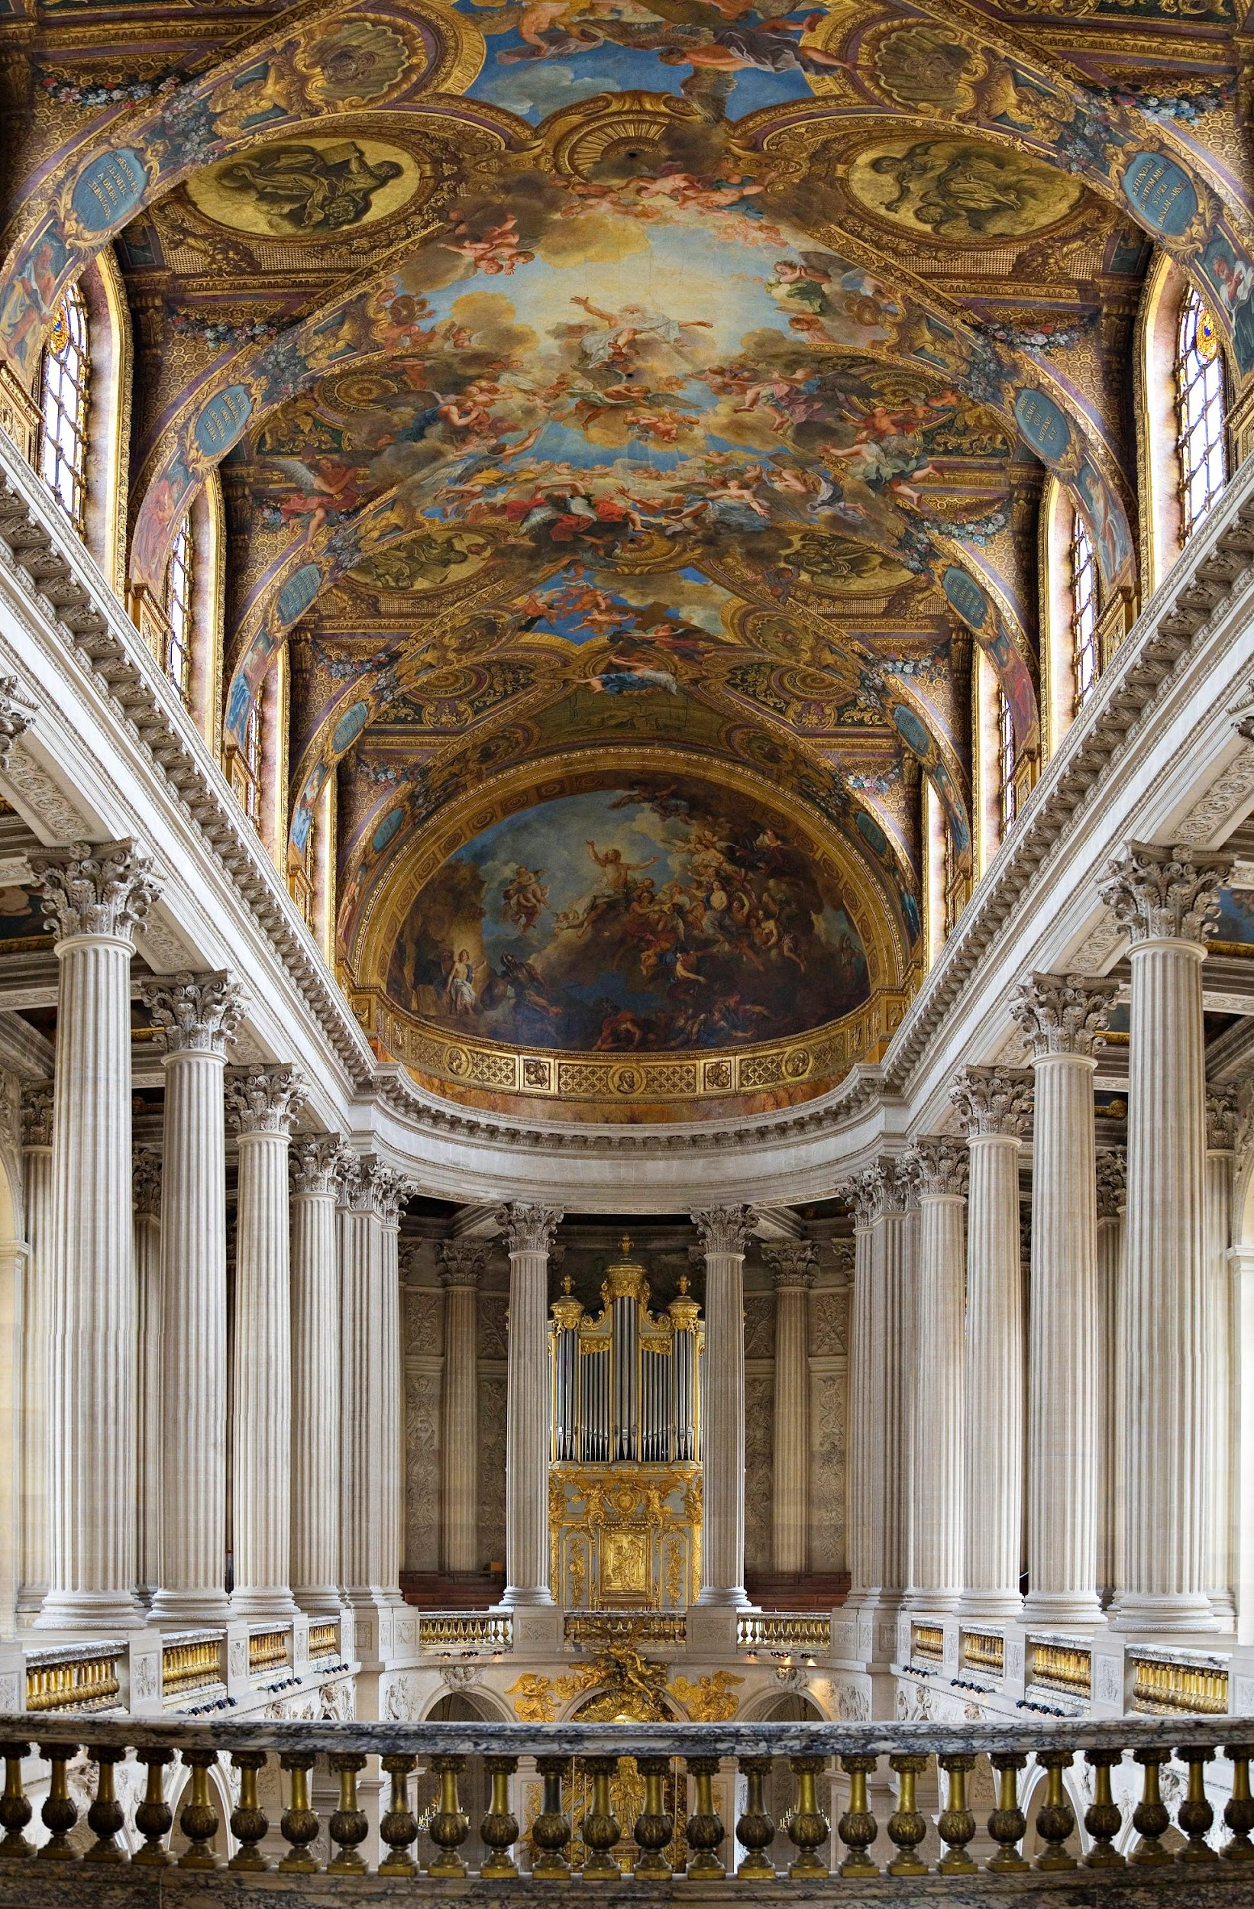

Slide 17
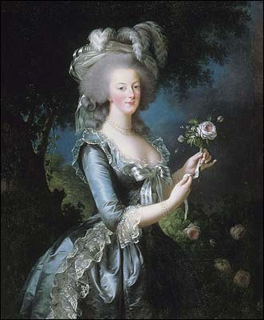

Slide 18
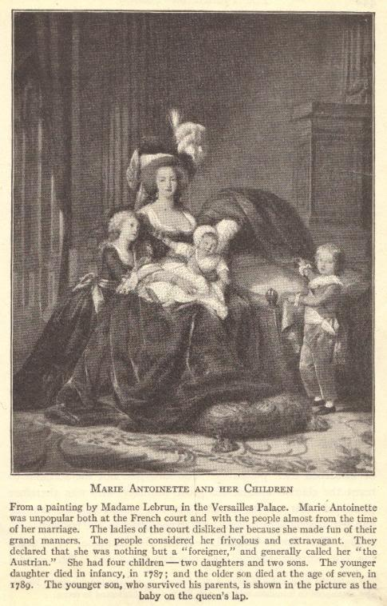

Slide 19
Philosophy of the French Revolution: The Enlightenment (Age of Reason)
Renaissance
Scientific Revolution
Intellectuals – philosophes – began to ask if natural laws might also apply to human beings
Philosophes were secular in thinking – they used reason and logic, rather than faith, religion, and superstition, to answer important questions
Used reason and logic to determine how governments are formed
Questioned the divine right of kings

Slide 20
Long- and Short-term Causes
Long-term causes
Also known as underlying causes
Causes which can stem back many years
Short-term causes
Also known as immediate causes
Causes which happen close to the moment the change or action happens
Example: A person is fired from his or her job.
Long-term cause(s): The person is often late to work and is generally unproductive on the job.
Short-term cause(s): The person fails to show up for work and does not call the employer.
Key: One typically does not happen without the other. Events which bring important change (or action) need both long-term and short-term causes.

Slide 21
Long-term Causes of the French Revolution

Slide 22
Short-term Causes of the French Revolution

Slide 23
Preparing for the Estates-General
Winter of 1788-1789
Members of the estates elected representatives
Cahiers
Traditional lists of grievances written by the people
Nothing out of the ordinary
Asked for only moderate changes

Slide 24
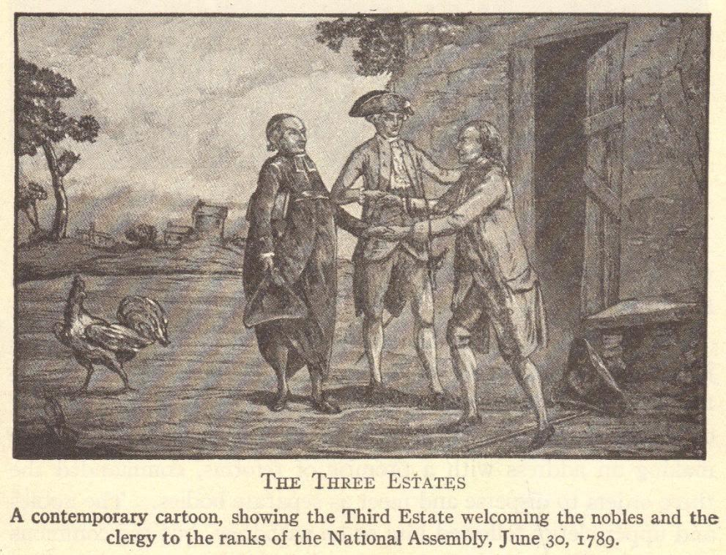

Slide 25
Meeting of the Estates-General: May 5, 1789
Voting was conducted by estate
Each estate had one vote
First and Second Estates could operate as a bloc to stop the Third Estate from having its way
◊ First Estate + ◊ Second Estate - vs. - ◊ Third Estate
Representatives from the Third Estate demanded that voting be by population
This would give the Third Estate a great advantage
Deadlock resulted

Slide 26
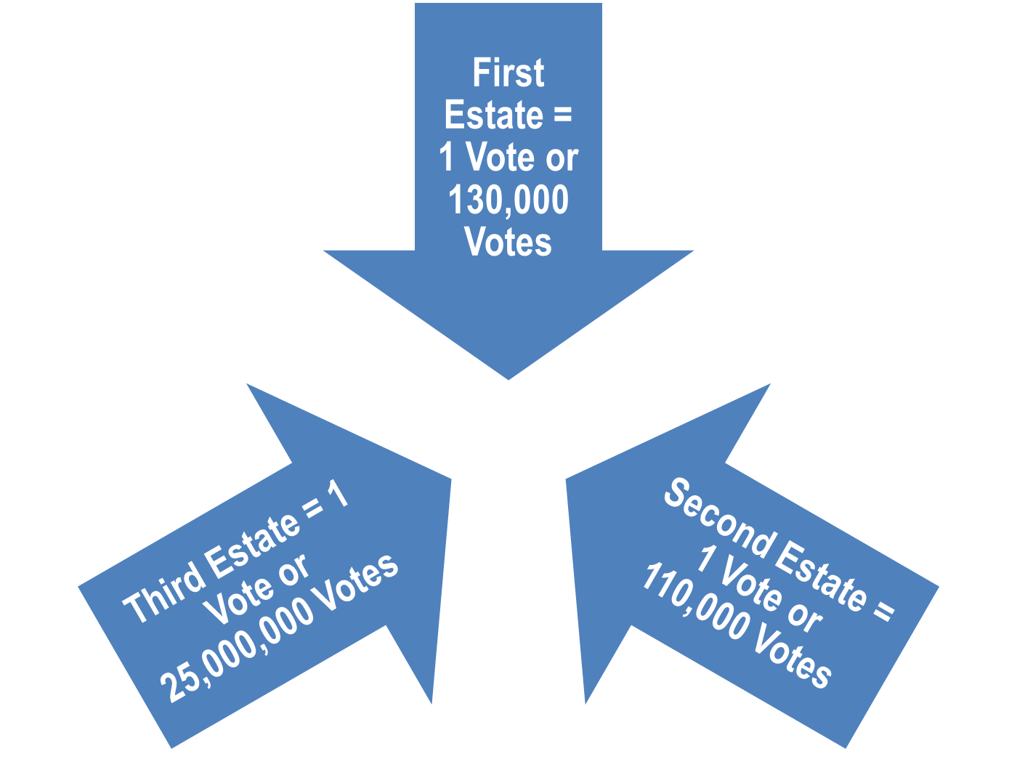

Slide 27
Tennis Court Oath

Slide 28
Tennis Court Oath by Jacques Louis David

Slide 29
The Tennis Court Oath
“The National Assembly, considering that it has been summoned to establish the constitution of the kingdom, to effect the regeneration of the public order, and to maintain the true principles of monarchy; that nothing can prevent it from continuing its deliberations in whatever place it may be forced to establish itself; and, finally, that wheresoever its members are assembled, there is the National Assembly;
“Decrees that all members of this Assembly shall immediately take a solemn oath not to separate, and to reassemble wherever circumstances require, until the constitution of the kingdom is established and consolidated upon firm foundations; and that, the said oath taken, all members and each one of them individually shall ratify this steadfast resolution by signature.”

Slide 30
Review Questions

Slide 31
Four Phases (Periods) of the French Revolution

Slide 32
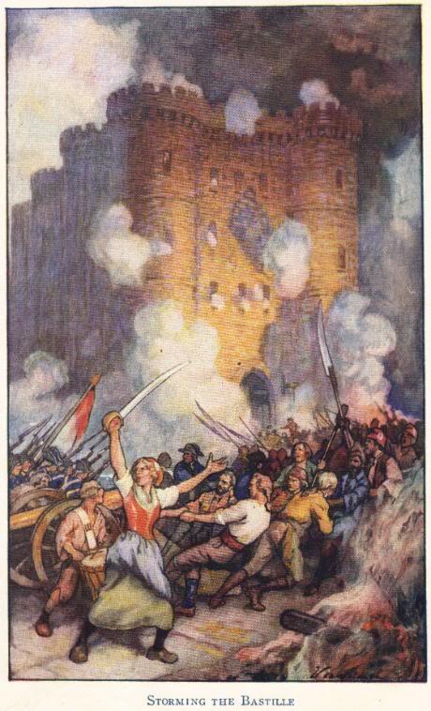
National Assembly (1789-1791)
Louis XVI did not actually want a written constitution
When news of his plan to use military force against the National Assembly reached Paris on July 14, 1789, people stormed the Bastille

Slide 33
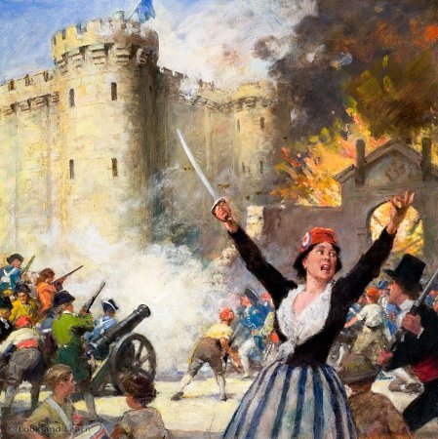

Slide 34
Uprising in Paris

Slide 36
Goodbye, Versailles! Adieu, Versailles!
Parisian Commune feared that Louis XVI would have foreign troops invade France to put down the rebellion
Louis XVI’s wife, Marie Antoinette, was the sister of the Austrian emperor
A group of women attacked Versailles on October 5, 1789
Forced royal family to relocate to Paris along with National Assembly
Royal family spent next several years in the Tuileries Palace as virtual prisoners

Slide 37
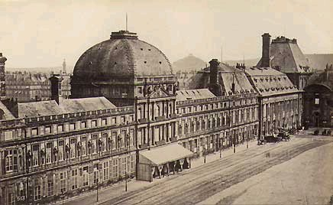
Tuileries Palace (Paris, France)

Slide 38
Changes under the National Assembly

Slide 39
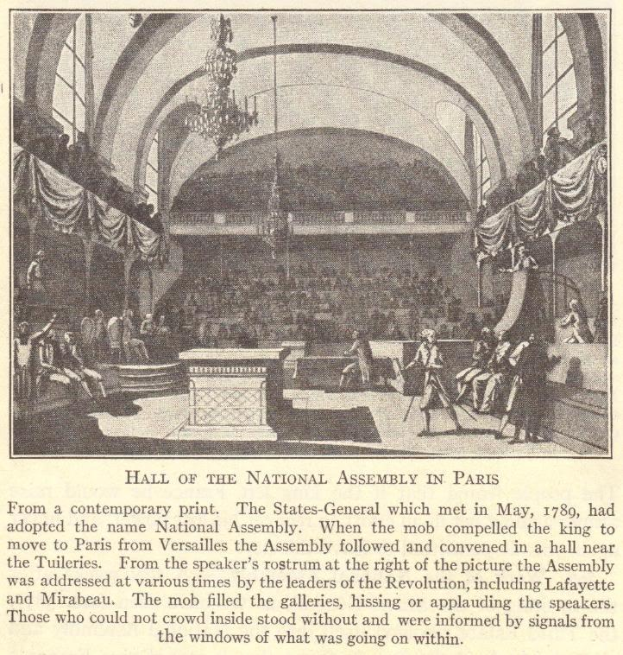

Slide 40
Declaration of the Rights of Man

Slide 42
End of Special Privileges
Church lands were seized, divided, and sold to peasants
Civil Constitution of the Clergy required that Church officials be elected by the people, with salaries paid by the government
2/3 of Church officials fled the country rather than swear allegiance to this
All feudal dues and tithes were eradicated
All special privileges of the First and Second Estates were abolished

Slide 43
Reforms in Local Government
The 30 provinces and their “petty tyrants” (Intendants) were replaced with 83 new departments
Ruled by elected governors
New courts, with judges elected by the people, were established

Slide 44
Constitution of 1791
Democratic features
France became a limited monarchy
King became merely the head of state
All laws were created by the Legislative Assembly
Feudalism was abolished
Undemocratic features
Voting was limited to taxpayers
Offices were reserved for property owners
This new government became known as the Legislative Assembly

Slide 45
Legislative Assembly (1791-1792)
Royal family sought help from Austria
In June, 1791, they were caught trying to escape to Austria
Nobles who fled the revolution lived abroad as émigrés
They hoped that, with foreign help, the Old Regime could be restored in France
Church officials wanted Church lands, rights, and privileges restored
Some devout Catholic peasants also supported the Church
Political parties, representing different interests, emerged
Girondists
Jacobins

Slide 46
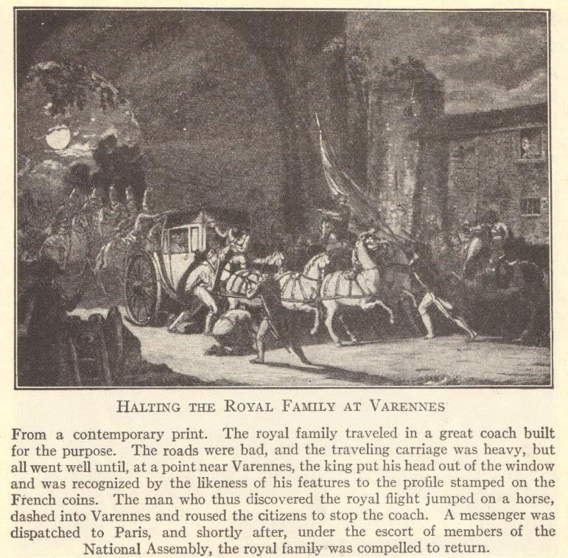

Slide 47
Opposition to the New Government
European monarchs feared that revolution would spread to their own countries
France was invaded by Austrian and Prussian troops
In the uproar, the Commune took control of Paris
Commune was led by Danton, a member of the Jacobin political party
Voters began electing representatives for a new convention which would write a republican constitution for France
A republic is a government in which the people elect representatives who will create laws and rule on their behalf
Meanwhile, thousands of nobles were executed under the suspicion that they were conspirators in the foreign invasion

Slide 48
Convention (1792-1795)
On September 22, 1792, the Convention met for the first time
Established the First French Republic
Faced domestic opposition and strife
Girondists were moderates who represented the rich middle class of the provinces
Jacobins (led by Marat, Danton, and Robespierre) represented workers
Faced opposition from abroad
Austria, England, Holland, Prussia, Sardinia, and Spain formed a Coalition invading France

Slide 49
Abolishment of the Monarchy
The Convention abolished the monarchy
As long as the royal family lived, the monarchy could be restored
Put the royal couple on trial for treason
Convictions were a foregone conclusion
Louis XVI was guillotined on January 21, 1793
Marie Antoinette was guillotined on October 16, 1793
Daughter Marie-Thérèse was allowed to go to Vienna in 1795
She could not become queen because of Salic law, which did not allow females to succeed to the throne
Son Louis-Charles, a.k.a. Louis XVII (lived 1785-1795) was beaten and mistreated until he died in prison

Slide 50
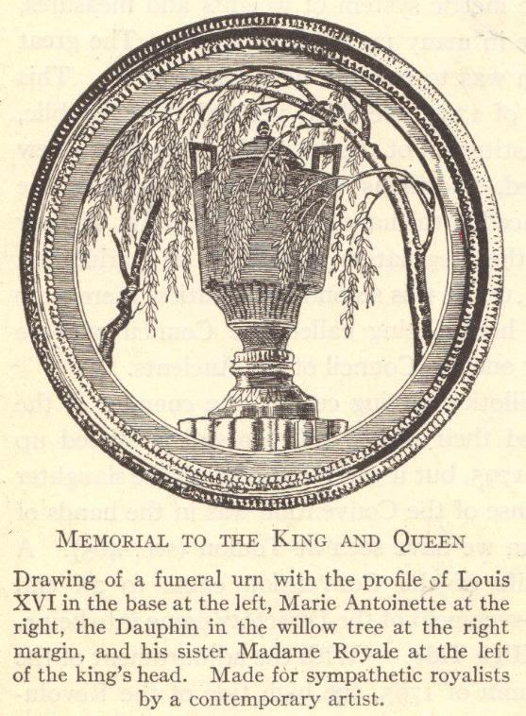

Slide 51
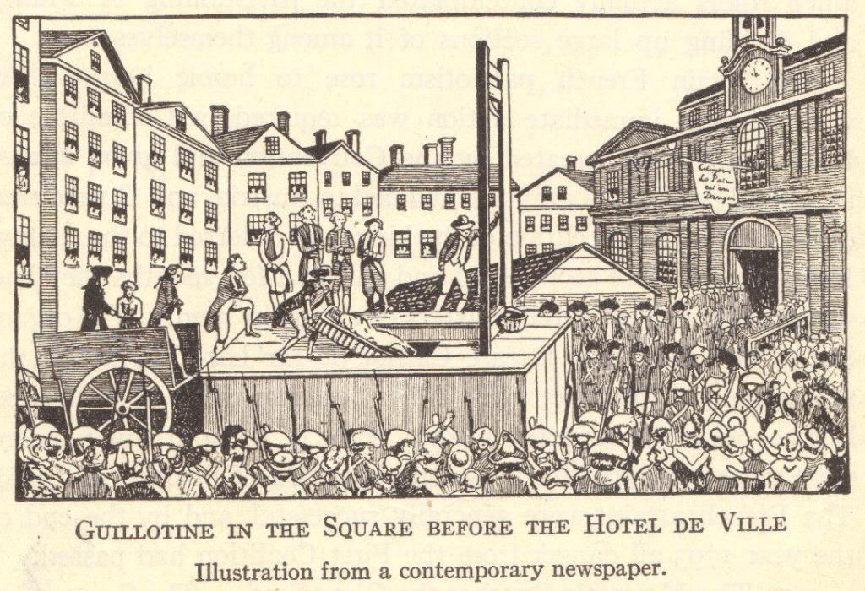

Slide 52
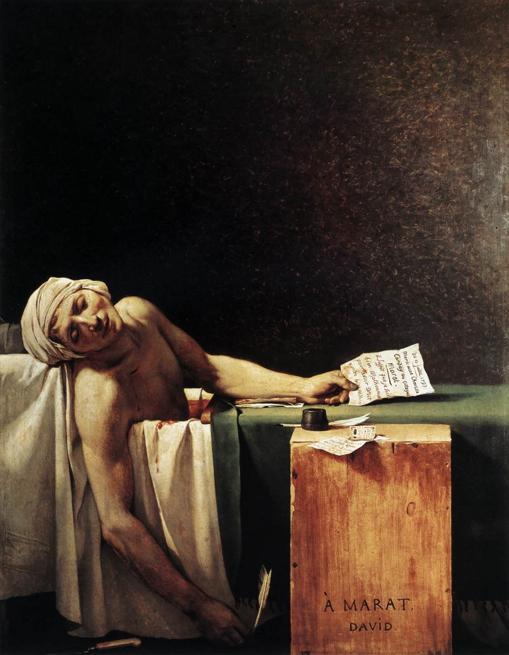
The three most memorable Jacobins were Georges Danton, Maximilien Robespierre, and Jean-Paul Marat.
Because of a debilitating illness, Marat was eventually forced to work from home. He was assassinated (in the tub while taking a medicinal bath) by Charlotte Corday, a Girondist sympathizer, in July, 1793.
The Death of Marat by Jacques-Louis David

Slide 53
Growing Coalition against the French
Convention drafted Frenchmen into the army to defeat the foreign Coalition
These troops were led by General Carnot
The people supported military operations because they did not want the country back under the Old Regime
Rouget de Lisle wrote the “Marseillaise”
Became the French national anthem
Inspired troops as they were led into battle
After two years
Coalition was defeated
France had gained, rather than lost, territory

Slide 54
Reign of Terror: September 5, 1793-July 27, 1794
Despite military successes, the Convention continued to face problems domestically
Danton and his Jacobin political party came to dominate French politics
Committee of Public Safety
Headed by Danton (and later Robespierre)
Those accused of treason were tried by the Committee’s Revolutionary Tribunal
15,000-40,000 people died on the guillotine
Guillotine became known as the “National Razor”
Including innovative thinkers like Olympe de Gouges and Madame Jeanne Roland

Slide 55
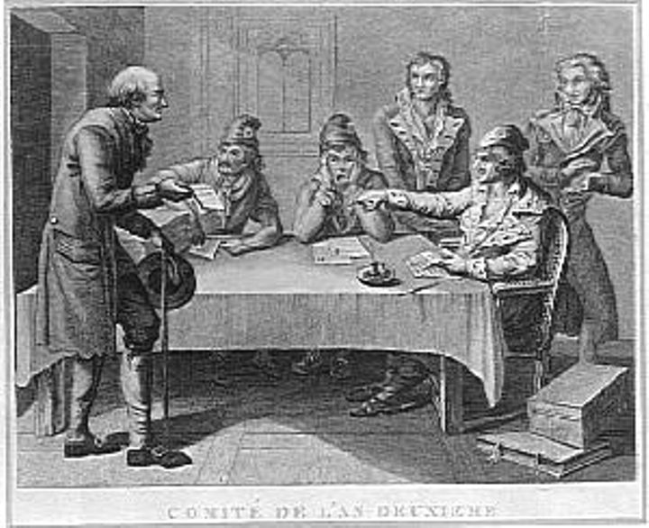
Committee of Public Safety

Slide 56
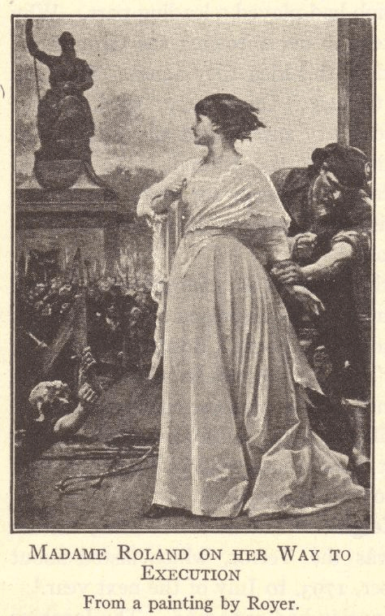

Slide 57
End of the Reign of Terror
Members of the Girondist political party tried to end the Reign of Terror initiated by the Jacobin political party
This opposition to the Committee of Public Safety caused many Girondists to be tried and executed for treason
Eventually, even Georges Danton wanted to end the executions
This resulted in Danton being tried and executed for treason
Maximilien Robespierre became leader of the Committee of Public Safety
He continued the executions
Convention came to blame Robespierre for the Reign of Terror
Reaction to Reign of Terror
July 27, 1794 – ended the Reign of Terror
Convention sent Robespierre and other members of the Committee of Public Safety to the guillotine
Robespierre was guillotined on July 28, 1794

Slide 58
Constitution of the Year III of the Republic (1795)
With the foreign invaders vanquished and the Reign of Terror at an end, the Convention was finally able to inaugurate its new constitution
Constitution of the Year III of the Republic (1795) created the Directory

Slide 59
Government under the Directory

Slide 60
Other Parting Reforms Passed by the Convention

Slide 61
Directory (1795-1799)

Slide 62
Review Questions

