Slide 1
Human Geography
Diffusion Scale Regions Spatial Demographics
Gender Sustainability Environment

Slide 2
AP Human Geography
1. Geography: Its Nature and Perspectives
2. Population Geography
3. Cultural Patterns and Processes
4. Political Organization of Space
5. Economic Development
6. Agriculture and Rural Land Use
7. Industrialization
8. Settlement and Services
9. Cities and Urban Land Use

Slide 3
Five Themes of Geography
Location
Place
Region
Movement
Human-Environment Interaction

Slide 4
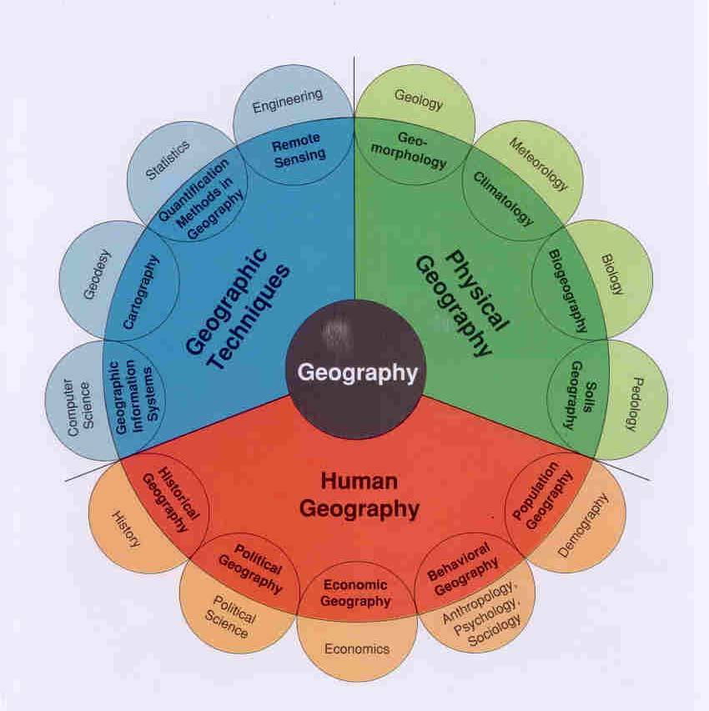

Slide 5
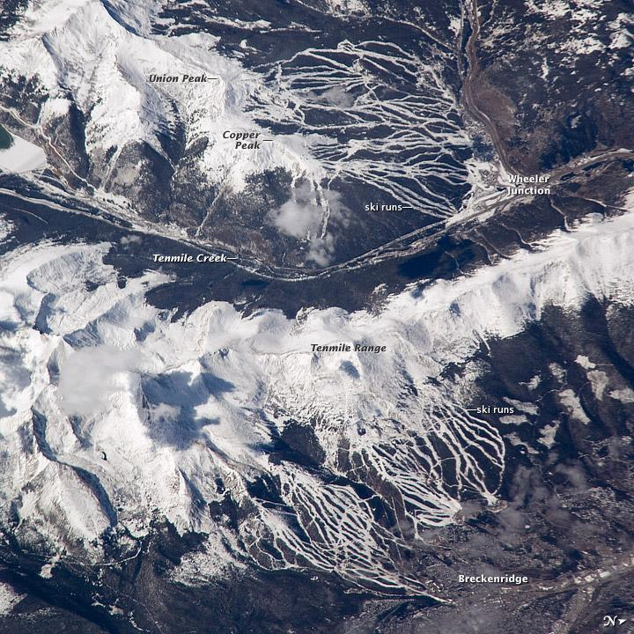
Human-Environment Interaction the way people and their environments interrelate and interact.

