Slide 1
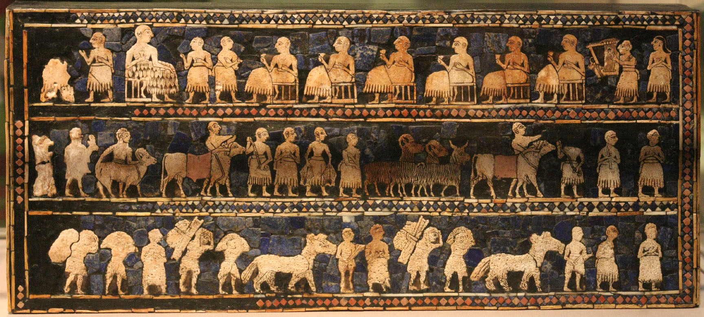
River Valley Civilizations
Ancient Sumer

Slide 2
6 Traits of a Civilization reading
Stable Food Supply
Writing
Culture
Technology
Government
Religion

Slide 3
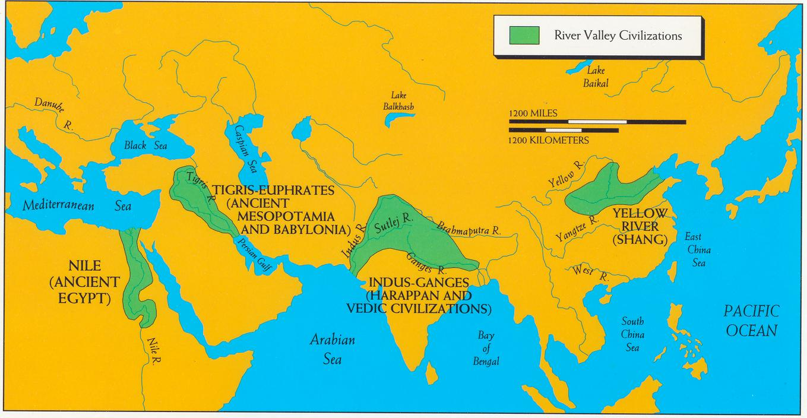
The Four River Valley Civilizations (about 3500-500 B.C. or B.C.E.)
=other early civilizations

Slide 4
Mesopotamia
The Mesopotamian civilization grew up around the Tigris and Euphrates River Valleys.
The “land between the rivers” (in Greek, Mesopotamia) offered rich soils for crop growing because of yearly flooding. Water irrigation developed for more reliable farming.
Mesopotamia was part of the rich growing region of the Fertile Crescent.

Slide 5
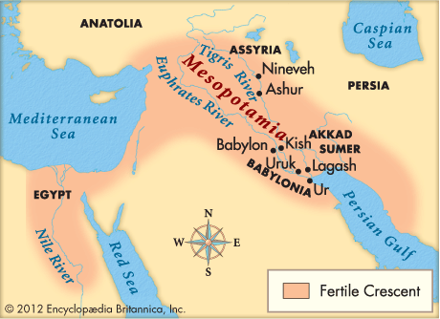

Slide 6
Agriculture
Sumerians invented:
irrigation to pull water from the Tigris and Euphrates Rivers.
Human or Ox drawn plows
How did a surplus of grain contribute to civilizations?

Slide 7
City-states Ruins of Ur
City-state = A small independent state consisting of an urban center and the surrounding agricultural territory.

Slide 8
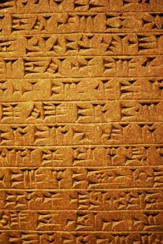
Writing-Cuneiform
Pictographs – symbols for objects
Ideograms – symbols for ideas

Slide 9
Reconstructing History Activity
With a partner look at one contemporary object on which writing is found, such as a penny.
Imagine that you are from the distant future. You know the English language, but you know little else about America in the 21st century. What hypotheses can you make from a penny (your object)? Example: The members of this unknown civilization:
could work metal
constructed buildings as shown on the reverse of the coin
wore facial hair
believed in a Supreme Being … and so forth

Slide 10
Cuneiform Activity
The first writing recorded agricultural transactions. What kinds of thoughts, ideas, actions, or things were easiest to put into pictures? What kinds of things did they believe were the most necessary to keep a record of? Try to imagine why it is that agricultural transactions—were among the first written messages on earth.
Why was it so important to have a written record of agricultural transactions?
Who besides the seller and the buyer might want a record of these transactions?
What other records might have been useful for authorities to keep? Might they want to keep track of marriages? Births? Deaths? Land sales? Why?
How else might rulers be able to use writing to legitimize and extend their power?
http://www.smm.org/anthropology/cuneiform/catalog/smm01

Slide 11
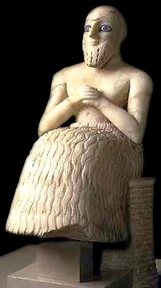
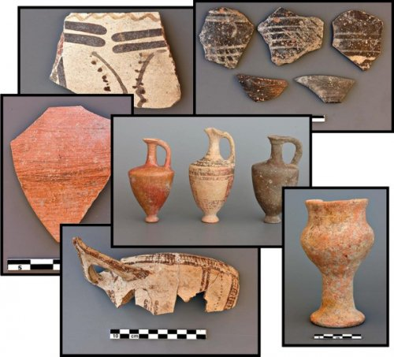
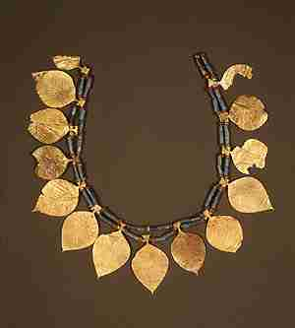
Culture
Pottery
Headdresses
Music
Drums, Pipes, and Lyres (right)
Figurines

Slide 12
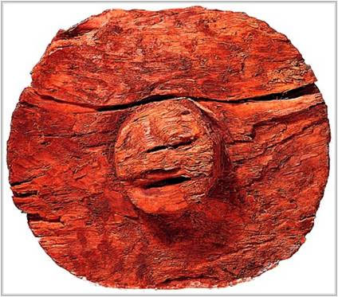
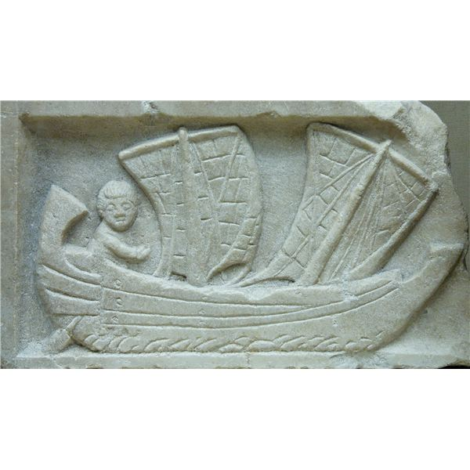
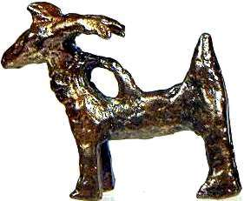
Other Technology
Sumerians invented:
Sailboats
Dikes
The Wheel!
Invented Potter’s wheel
Arches/Ramps
Metallurgy
Copper, gold and worked to create bronze.

Slide 13
Plow

Slide 14
Religion Ziggurats
Multi-story, mud brick pyramid shaped tower approached by ramps and stairs.
Places of worship for the Sumerian Gods

Slide 15
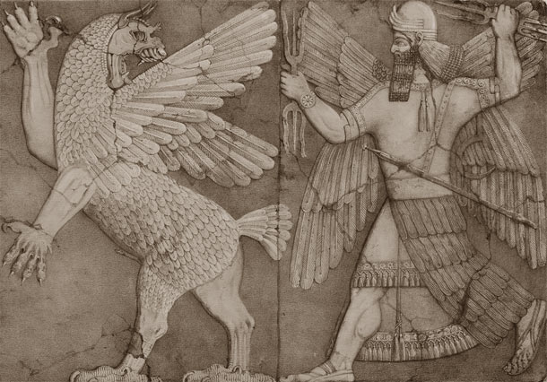
Religion Sumerian Gods
Polytheist:
3000 gods
Human like, had faults, and feelings but non-human since they were immortal.
Embodied the forces of nature.

Slide 16
Epic of Gilgamesh
Epic Poem from Ancient Mesopotamia from Ur (circa 2100 BC).
The epic adventures of king of Uruk, who was two-thirds god and one-third man.

Slide 17
Government
The earliest leaders were priests.
First Sumerian King emerged in the third millennium BCE. He was called the lugal or “Big Man”
Sumerian City-states were ruled by Kings and they ruled by divine right.
First to set formal laws.
Hammurabi’s Code (1750 BC)E

Slide 19
Hammurabi r. 1792 BCE-1750 BCE
Hammurabi was the ruler of Babylon (the largest and most important city in Mesopotamia).
Conquered many city-states in Mesopotamia.
Wrote code of laws that were inscribed on a black stone pillar that illustrated the principles to be used in legal cases.
“eye for an eye”
Reflected the three social classes.

Slide 20
The Code of Hammurabi
1)What does the Code of Hammurabi tell us about the class structure in Babylon? Make specific reference to at least three of the laws listed to back up your response.
2)What can be said about the Babylonians attitudes towards (make reference to at least one law from the code):
family?
property?
the value of human life?.
3)What value and morals appear to be most important to the Babylonians?
4)Does it matter to the Babylonians if an action is deliberate or accidental? What does this tell us about their society?

