Slide 1
Mycenaean Greece
Early Greek Civilizations

Slide 2
Who were the Ancient Greeks?
People who lived near the Mediterranean Sea between 2000 BCE and 500 CE.
Greeks identified themselves by their palace-states or kingdoms, not as “Greeks” during the Bronze Age and Dark Age.
Unifying factor. Spoke Greek (Indo-European language).

Slide 3
Impact of Geography
Trade was a necessity (lack of agriculture and other resources)
Outdoor lifestyle.
Warfare over lack of resources

Slide 4
Greek Gods
The Greeks believed in polytheism and that the Gods walked the earth along side them.
God’s were immortal.
The Gods were more powerful and more beautiful than humans.
God’s were much like humans, they ate, drank, fell in love, had children, got angry and got in trouble.
Zeus was the King of Gods and the lord of the sky.
Gods enjoyed gifts and accolades.
Greek Priests took charge of temples and offered sacrifices to the gods.

Slide 5
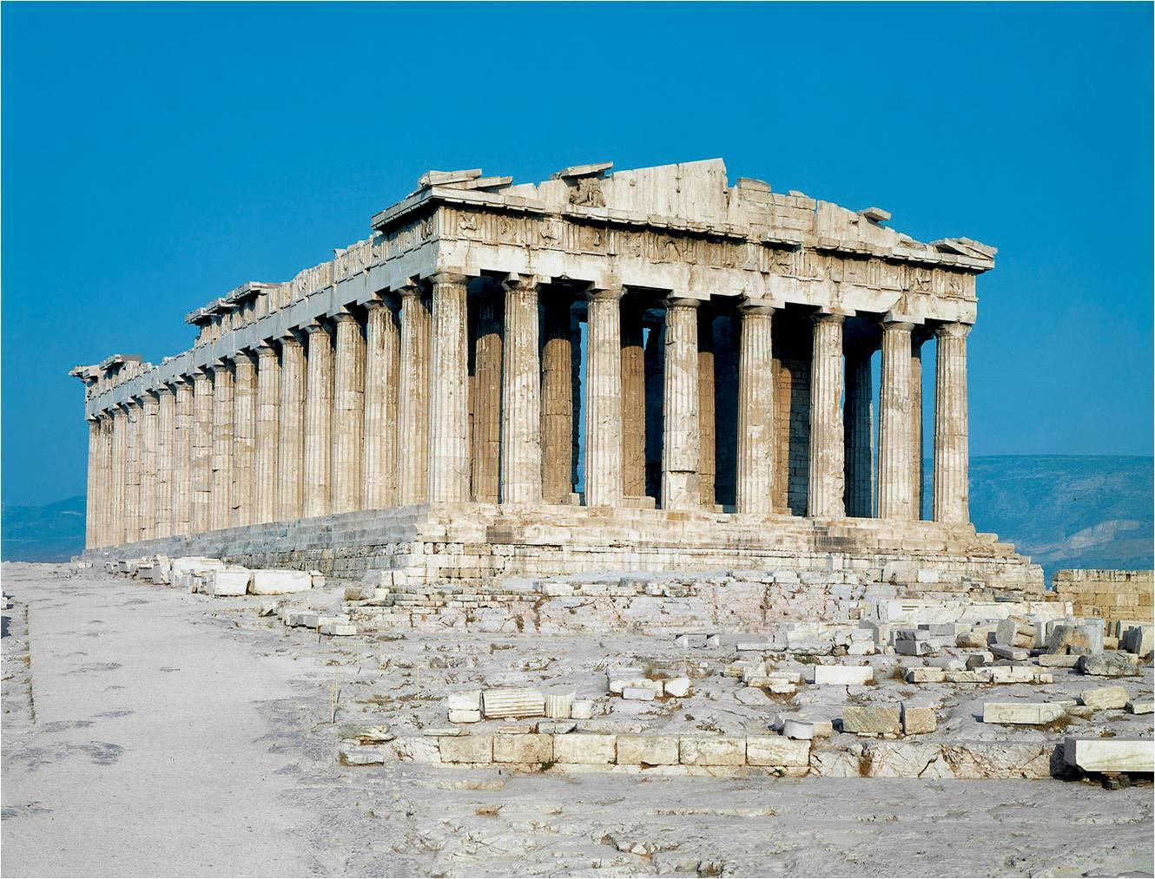
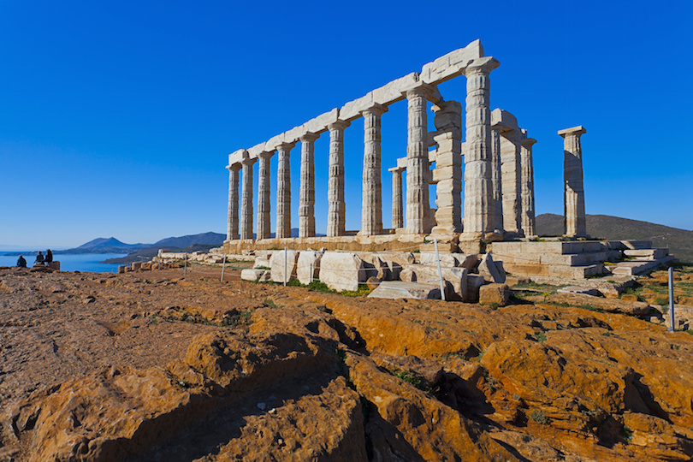
Shrines of the Greek Gods and Goddesses
Temple of Poseidon -at Sounion surrounded on three sides by the sea. It was constructed in approx. 440 BC.
The Parthenon -temple of goddess Athena on the Athenian Acropolis, Greece. Construction began in 447 BC

Slide 6
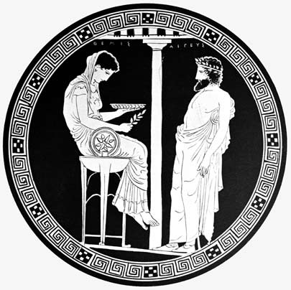
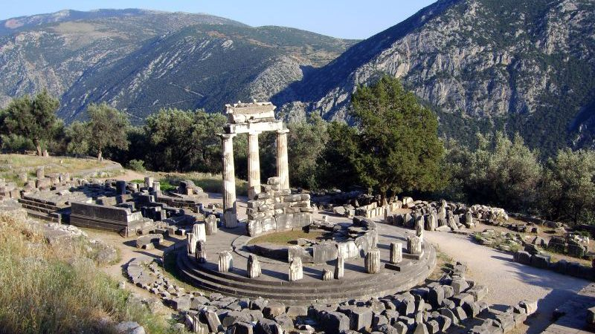
Oracles
An oracle is a place that had some special connection with a particular God.
An oracle was a person who was especially connected to a God and could speak for the God.
Oracle at Delphi
Prophet Pythia helped people reach the Sun God Apollo

Slide 7
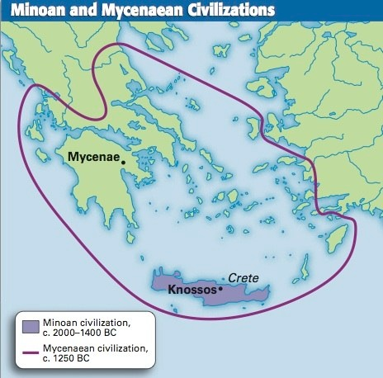

Slide 8
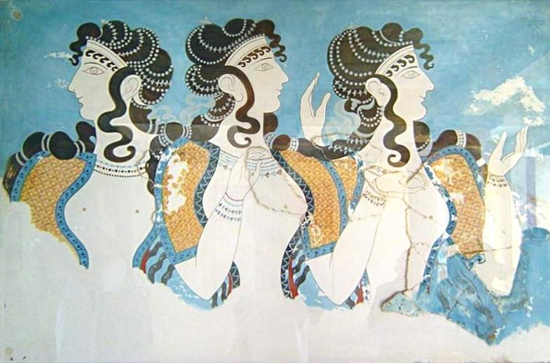
The Minoan Civilization 2600 BCE
Island of Crete
Palace of Knossos
Perhaps 40,000 people lived in the city.
Wealthy, advanced.
Ruined and buried until 1900 AD.
3000 clay writing tablets showing linear A (which we can’t read).

Slide 9
Why was Minoan Civilization important?
It was the first civilization of Europe and 5th in the world.
The origins of Greece and Greece is important to the origins of Western Civilization.
Traders of wine, honey, olive oil to Egypt Asia Minor, Syria and mainland Greece .

Slide 10
The Mycenaean's
The Mycenaean Greeks flourished between 1600-1200 BCE, during what is called the “Bronze Age”.
Territory included Peloponnese on the mainland of Greece, but also extended across the Aegean sea to Asia minor and to the Island of Crete.
The Mycenaean's were influenced by the earlier Minoan Civilization (2000-1450 BCE) which had spread from its origins at Knossos.
Conquered Crete 1450 BCE

Slide 11
Mycenaean Art
Architecture, art and religious practices were assimilated by the Mycenaean (from the Minoan’s) and adapted to better express the perhaps more militaristic and strict and severe Mycenaean culture.

Slide 12
The palace-state of Mycenae
Heinrich Schliemann, archaeologist found Mycenae in 1876
War-like setting, not beautiful like Minoans.

Slide 13
Why were the Mycenaean's Important?
Took over the Minoan's sea trade to Egypt, Phoenicia, Sicily and Italy.
Odysseus, Agamemnon, Menelaus, Achilles were from Mycenae
Known as Heroic Age

Slide 14
The Greek Dark Age (ca. 1100–800 BC)
Invasion from Greek speaking “Dorians” from the north
Coincides with Homeric Age
Period of illiteracy
Overseas trade decreased considerably
Poverty increased

Slide 15
Myth vs. History over the Trojan War
The Cause of the Trojan War (1250 BCE)?
The size of the Greek army?
The length of the “war”?
The city of Troy?
The Trojan Horse?
The heroes?

Slide 16
The Bard
During the dark age of Ancient Greece, Bards kept alive the Mycenaean traditions.
Bards:
Kept oral history alive by singing, or playing musical instruments.
As literacy emerged these oral traditions turned to written history.

Slide 17
History, Myth or a little bit of both?
Greeks were the first people who wrote about themselves.
The first people in the ancient western world to write what we now call history.
Some myths are loosely related to history, but most Greek myths are not history.

Slide 18
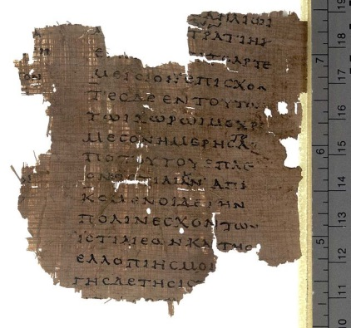
First Historians Herodotus (c. 484–425 BC)
Wrote the Histories (mid 5th C BCE): Narrative of traditions, government, geography and conflicts with other civilizations.
Discusses the Trojan War at several points in his Histories.
The Trojan war involved the Egyptians and a general war between the East and the West.

Slide 19
First Historians: Thucydides of Athens
Wrote The History of the Peloponnesian War 431 BCE.
Thucydides was concerned that people should know the difference between fact and myth.
Trojan war was fought over resources. Troy was a war of conquest.

Slide 20
But earlier, there was Homer
Not this Homer…

Slide 21
This Homer…

Slide 22
Homer (lived around 850 BCE ???)
Blind Poet
Wrote Iliad and the Odyssey.
He was believed by the ancient Greeks to have been the first and greatest of the epic poets.
First known literature of Europe.
Ancient Greeks looked to Homer’s works for all “how to” questions Homer’s works were education.

Slide 23
Trojan Wars
For generations, bards passed on tales of the heroes who fought at Troy.
Homer epic poem the Iliad describes the events of the 10 year long war between the Greeks and the Trojans

Slide 24
The Historic Trojan War
Since the 19th-century rediscovery of the site of Troy (western Turkey), archaeologists have uncovered increasing evidence of a kingdom that peaked and may have been destroyed around 1,180 B.C.

Slide 25
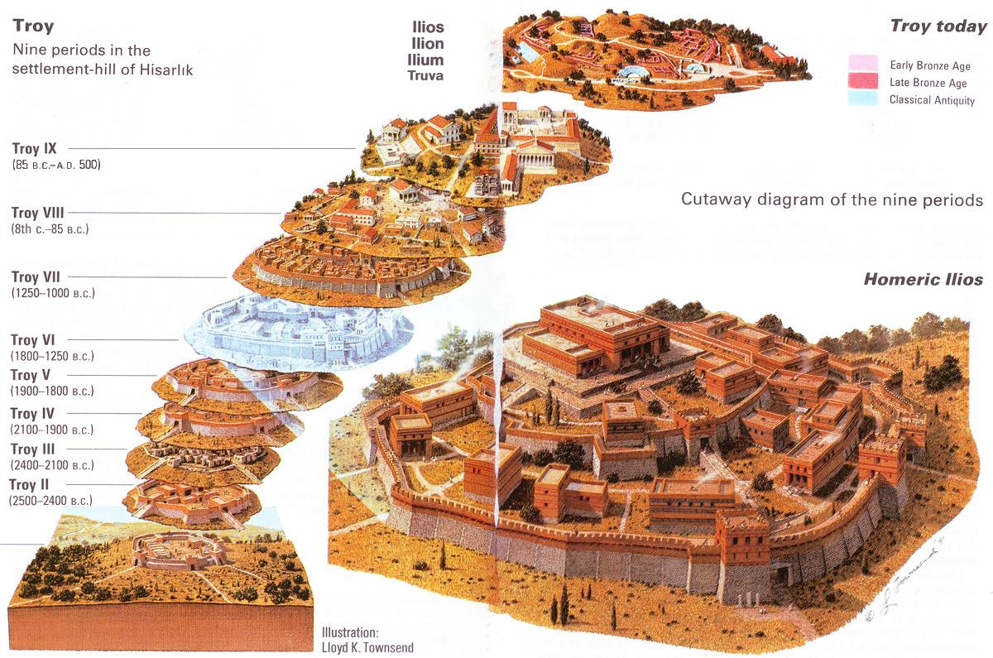

Slide 26
Myth vs. History over the Trojan War
The Cause of the Trojan War (1250 BCE)?
The size of the Greek army?
The length of the “war”?
The city of Troy?
The Trojan Horse?
The heroes?

